Slide 1
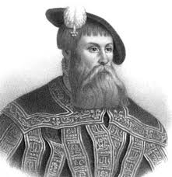
Did we really? An Introduction to Basic VTS and Remote Towers
”In comparison lies our perhaps most powerful tool”
Christer Winberg, Professor of History, University of Gothenburg

Slide 2
Presentation Table of Contents
VTS. History and purpose.
VTS Operator Crash Course (Video Recording and 7 – 8 questions).
History. Pilotage/VTS in Sweden 1963 – 2010, special emphasis on 1999, 2004 and 2010 (this is the Remote Towers part).
Did we really?
VTS in 2010 – 2020 STM (Sea Traffic Management) our great Game Changer.
2020 - ? Artificial Intelligence. RESKILL F-Auto, Auto MON (AIM).

Slide 3
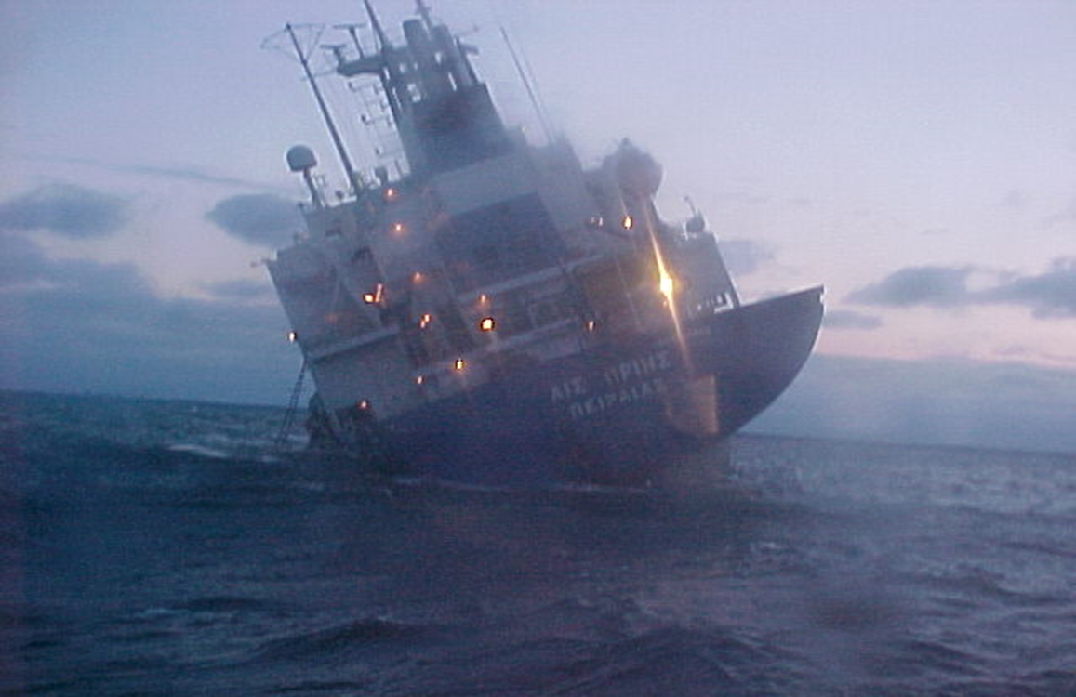
VTS (Vessel Traffic Services)
Three catch words:
Efficiency
Safety
Environmental Protection

Slide 4
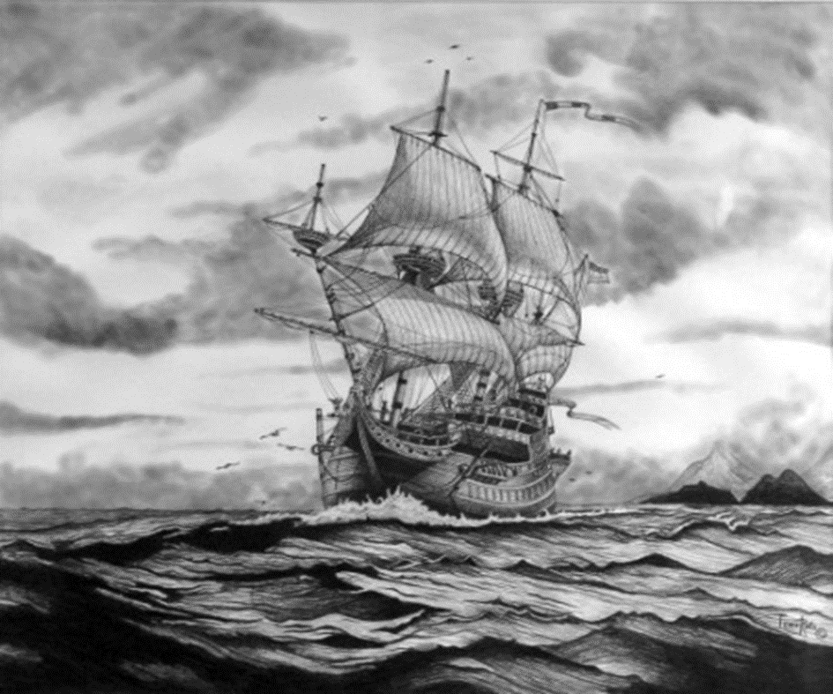
Maritime Shipping – A conveying branch since ancient times

Slide 5
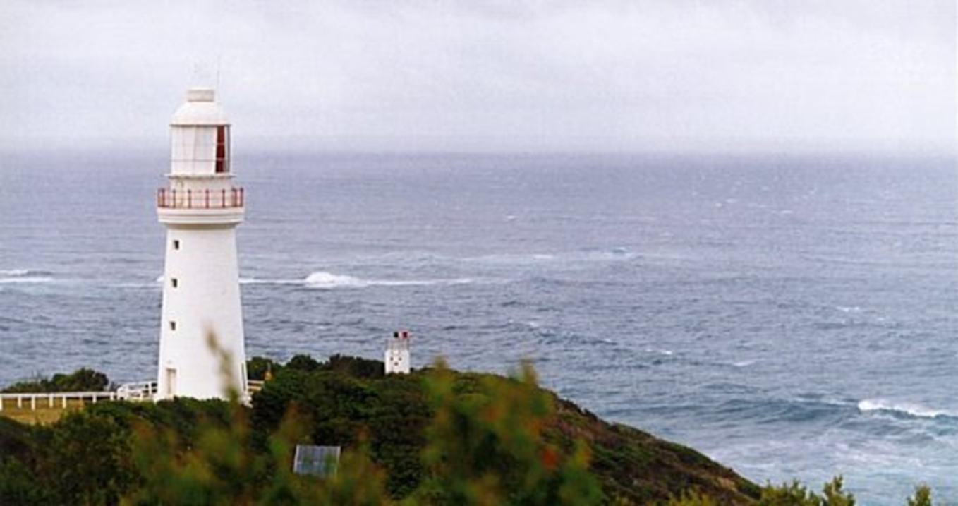
ATON (Aid to Navigation)
Lighthouses
Buoys
Beacons etc.

Slide 6
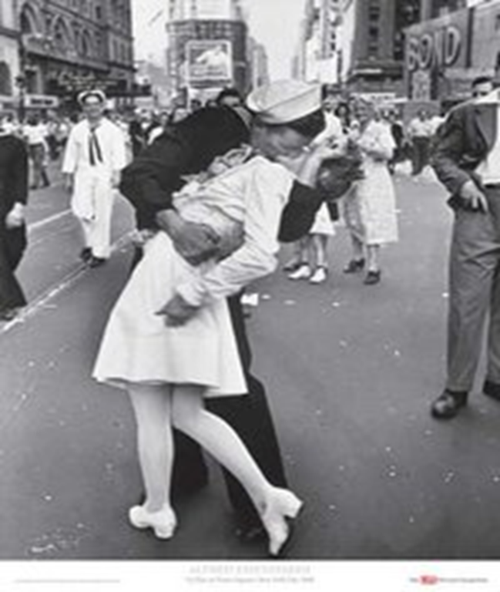
A new era after the Second World War
Europe must be rebuilt to a safe and stable place.
Industry is at full speed ahead.
Trading and shipping is booming.
Wheels are turning faster than ever before.
”Time is money!”

Slide 7

Fog - An obstacle that grew larger in the new era …

Slide 8
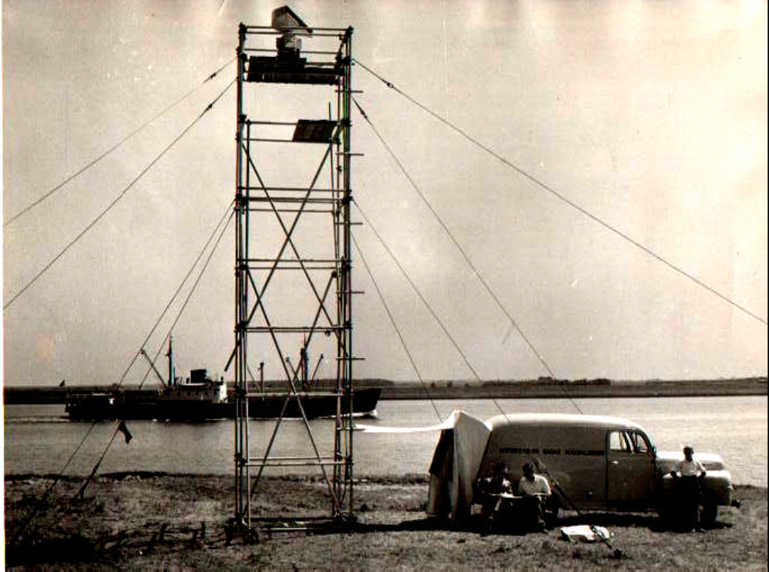
Efficiency
The contemporary maritime expertise believed in this: Shore based radar.
In 1948, a shore based radar station was opened on the Isle of Man and one in Liverpool. The picture shows a test station in Rotterdam the same year.
The over-all goal was to keep maritime traffic going even if it was foggy.

Slide 9
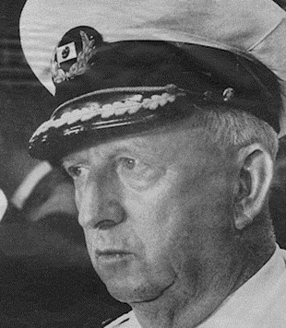
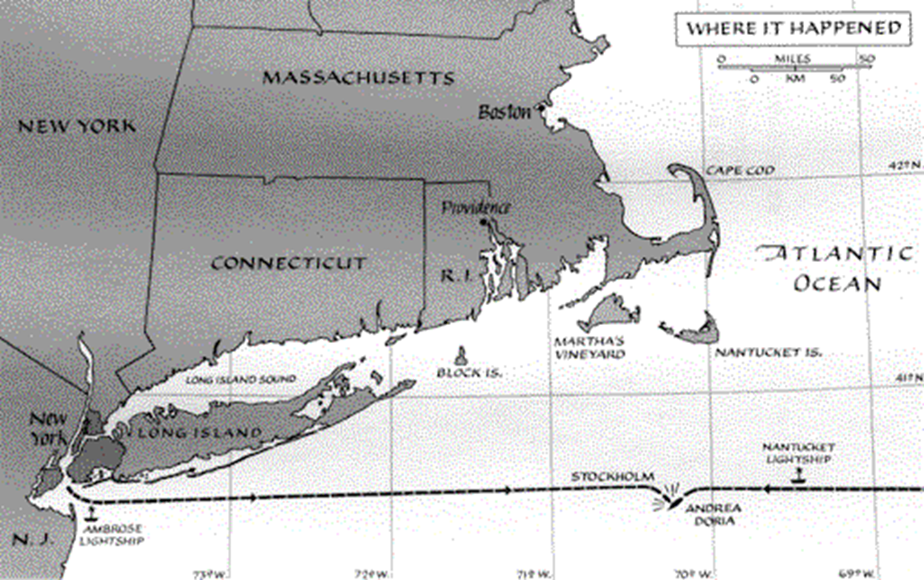
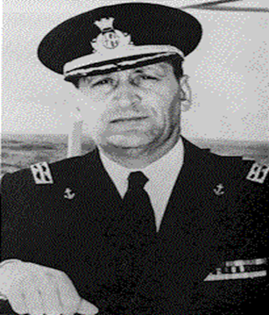
Safety?

Slide 10
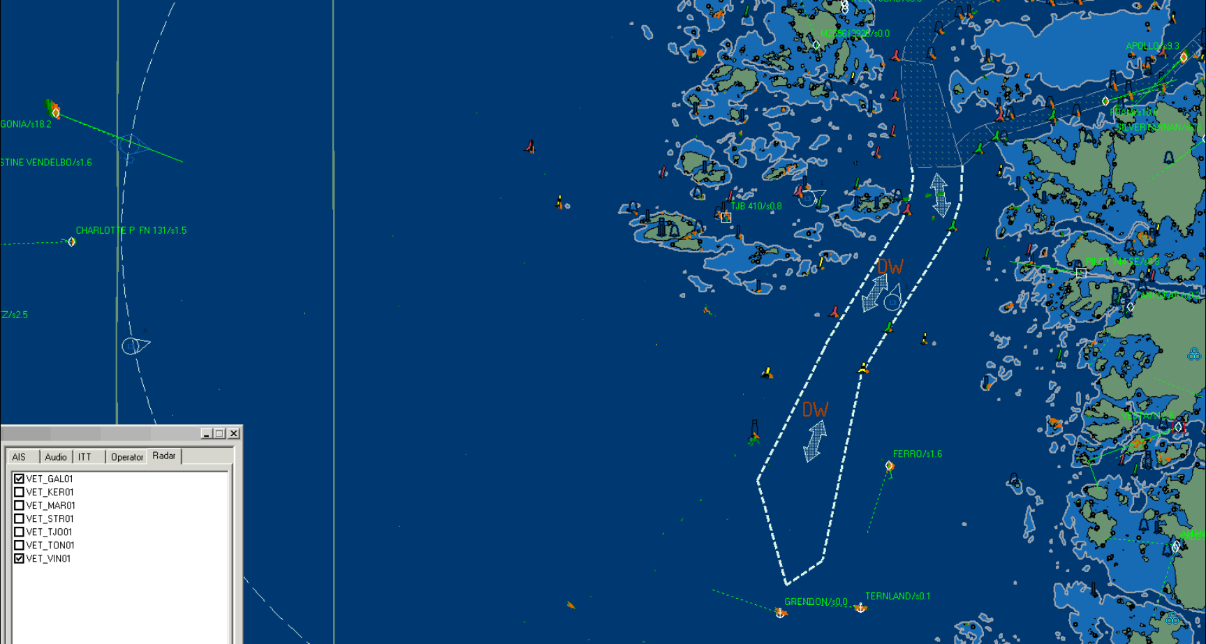
The VTS Operator Crash Course. 2012 Winter, dark, good visibility, VTS Gothenburg. 7 – 8 questions to be asked.

Slide 11
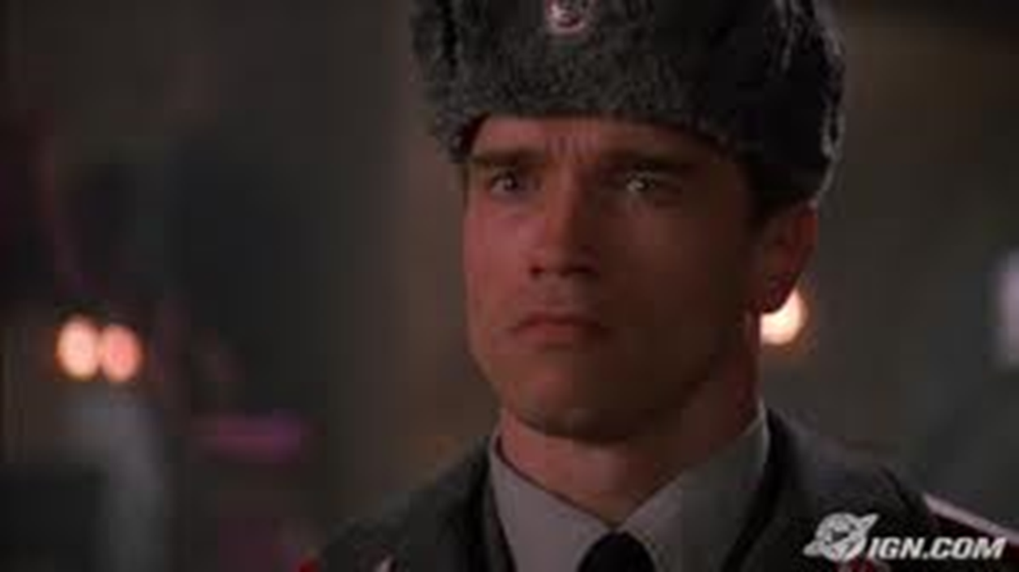
Red Heat

Slide 12
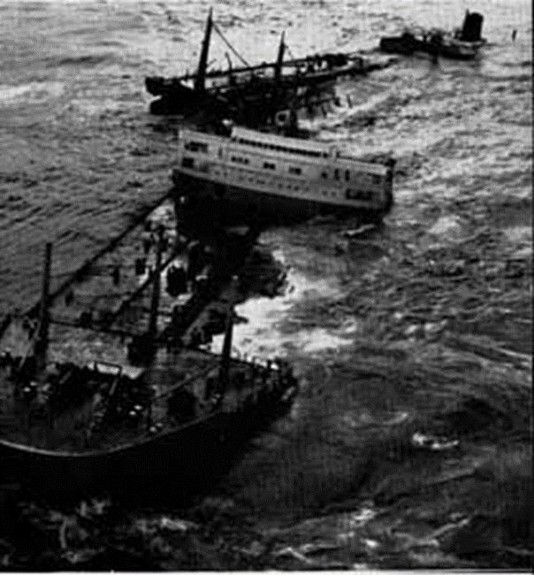
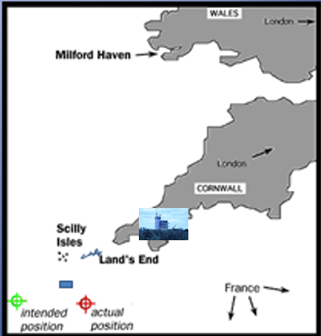
Environmental Protection
Torrey Canyon 1967
(I set up this VTS here.)

Slide 13
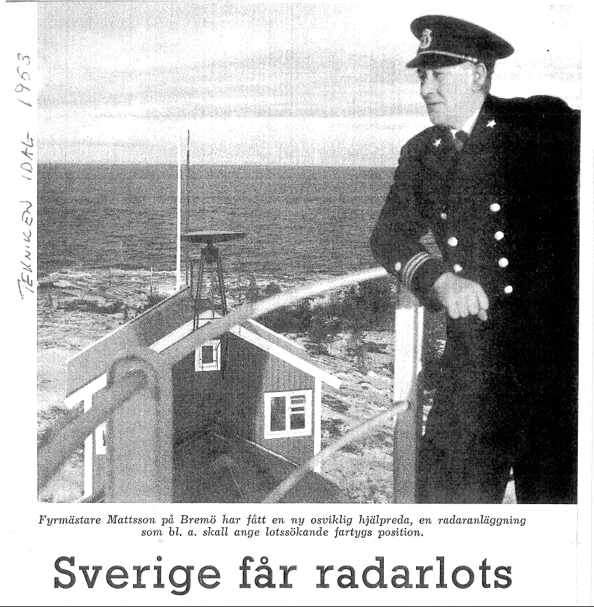
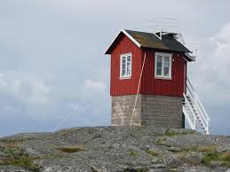
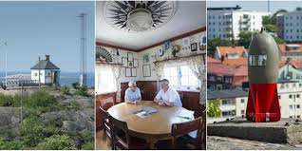
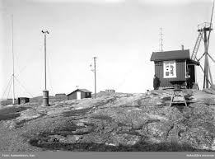
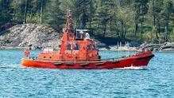
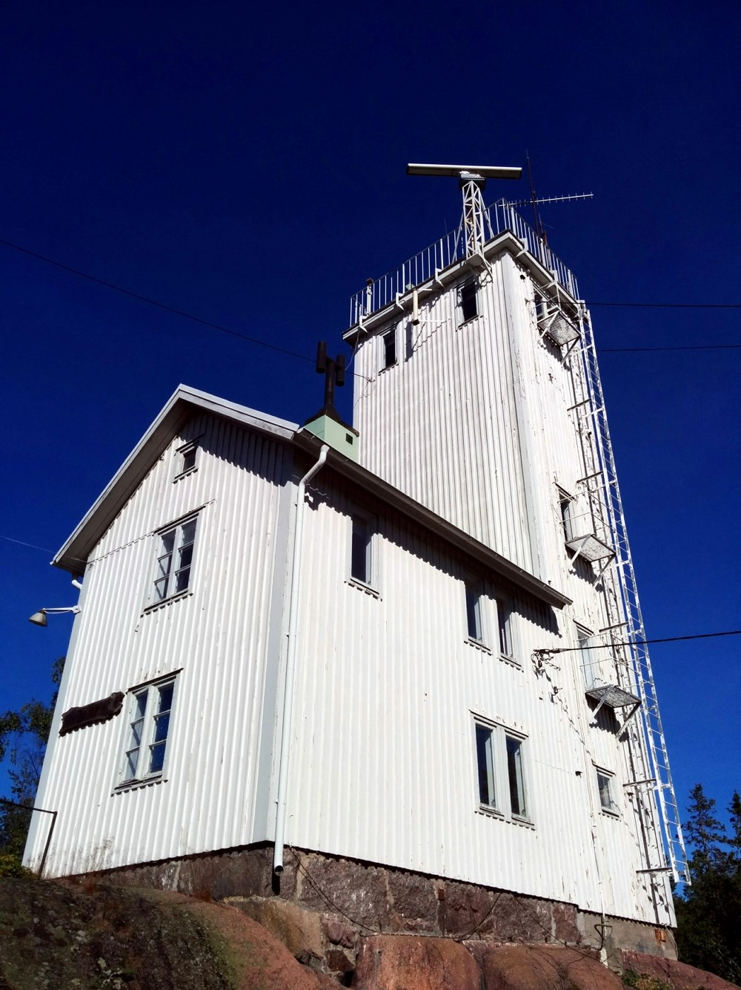
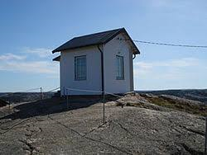
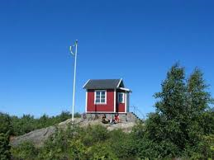
Remote Towers
Two tasks:
Administer Pilots.
Traffic Information to vessels in the fairway.
Also, the personnel manning the pilot look-outs drove the pilot boats. Boatmen.

Slide 14
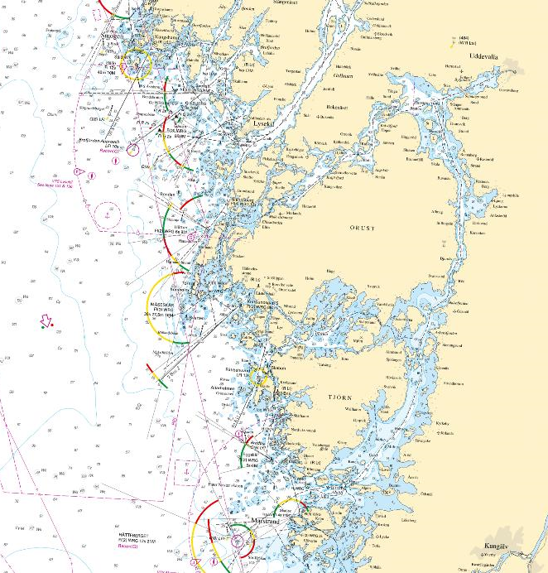
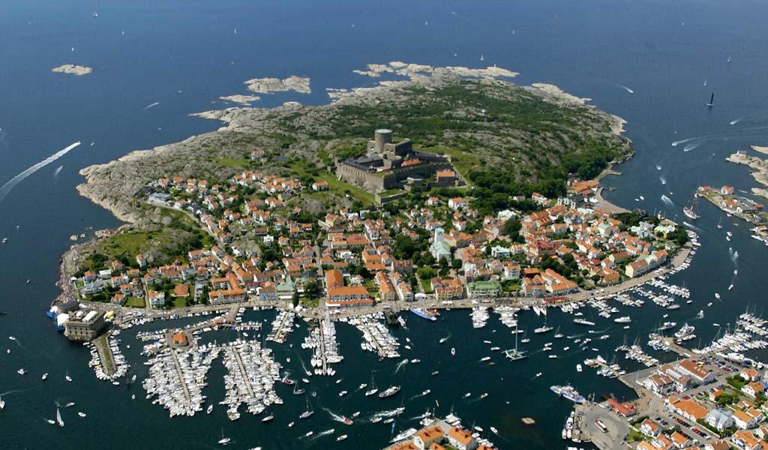
Things to consider before discussing Maritime Remote Towers
The size of the surveilled area.
The precision of the information given.
The background, culture and training when comparing Air Traffic Control with boatmen.
The authority of VTS vs ATC.
Speed?
40 M
(80 km)

Slide 15

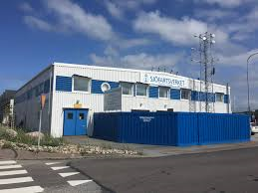
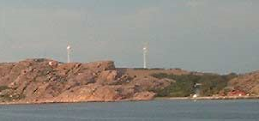
1999 (earlier in several places, but now the roles of the operators are slightly changed too)
Division of labour:
One person administering pilots.
One person giving Traffic Information and still manning the pilot boat.

Slide 16
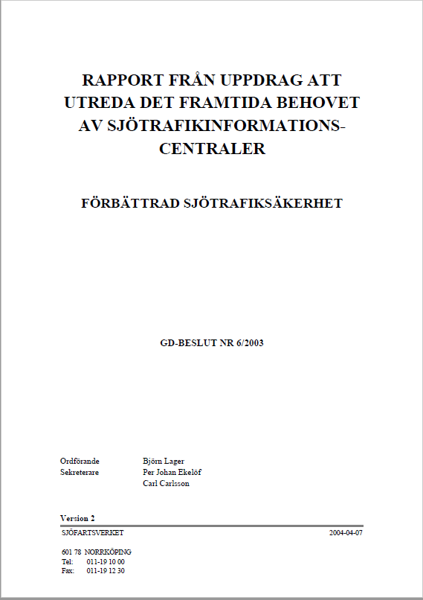
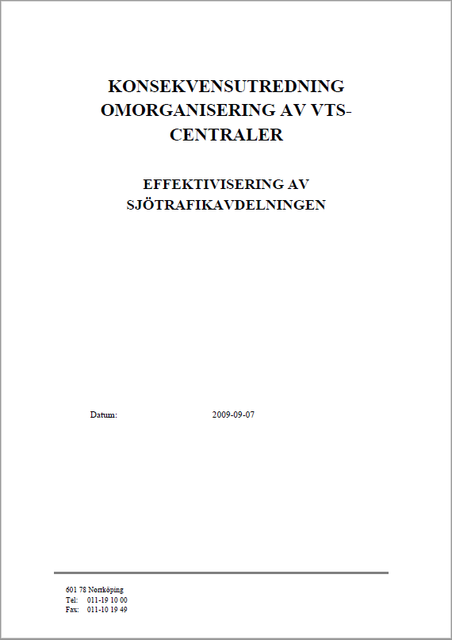
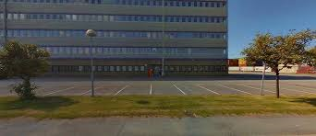
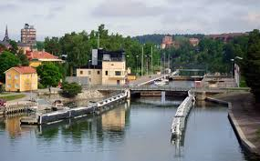
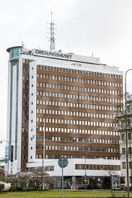
2004 - 2010
VTS West Coast
VTS East Coast
Sound VTS. (Co-operation with Denmark)

Slide 17
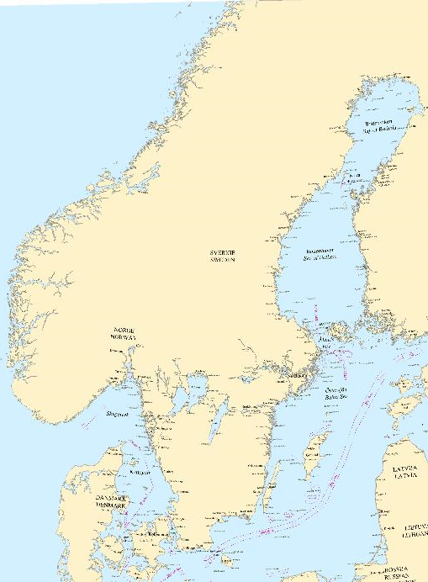
Nine VTS Areas (red arrows) and four VTS Centrals (blue arrows)
Did we really?
Marstrand
Södertälje
Gothenburg
Malmö

Slide 18
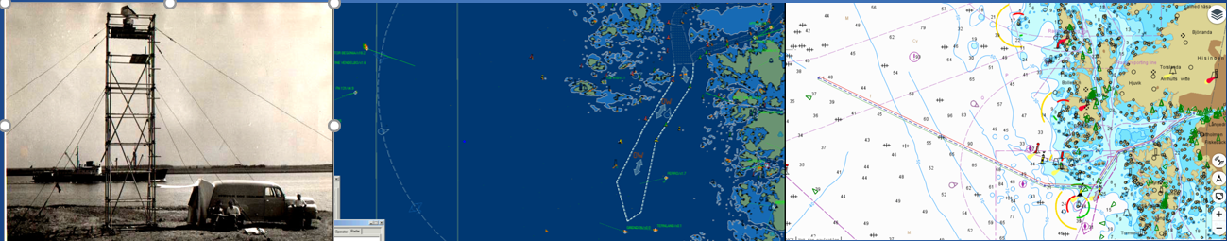
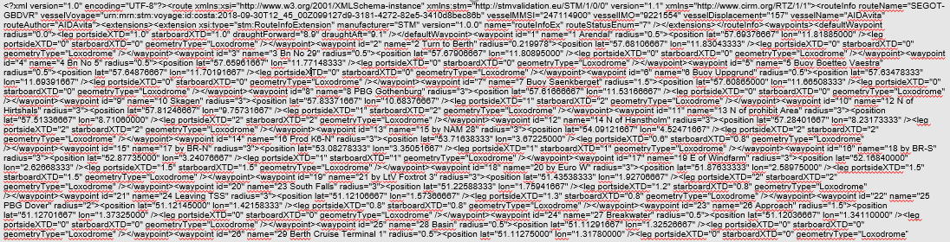
VTS High-Tech today – STM.
Sending Voyage Plans in an inter-operable format.

Slide 19
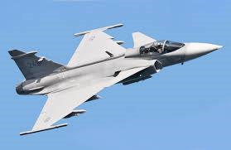
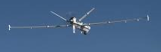
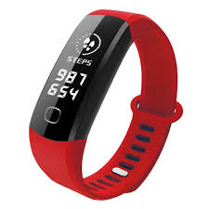

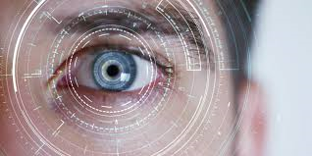
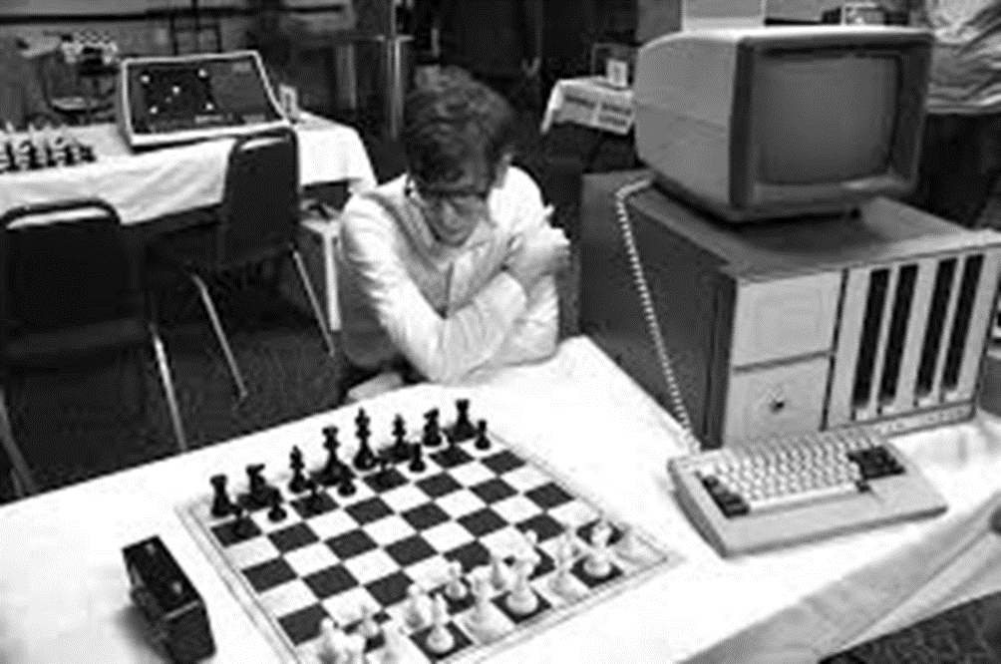
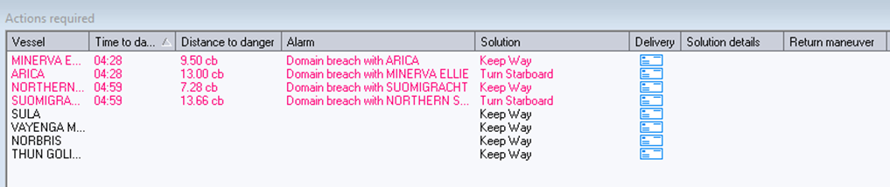
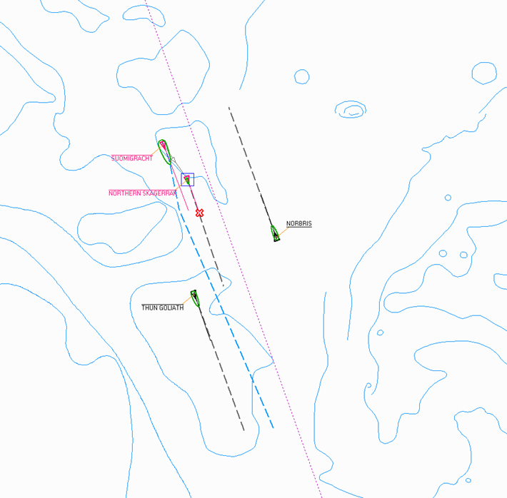
VTS High Tech soon - Artificial Intelligence
RESKILL (Transparent and Self-Explaining)
F-Auto (Decision Support based on technical sensors and on the status of the VTS Operator)
Auto Mon (Surveilling large VTS areas – all Swedish Waters)
AIM

Slide 20
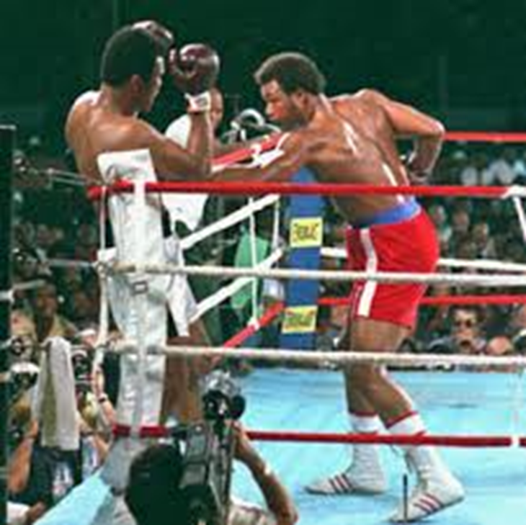

- Is that all you got, George!?
- Yeah, that´s pretty much it …
Ladies and gentlemen, thanks a lot for your time!
Any questions?

