Slide 1
When subjective is not enough
Tales of Automation and searching for the objective HP measure
07 Feburary 2019 – Norrköping, Sweden
Dr. Nathan Vink – Human Performance Lead, Austro Control

Slide 2

What is this?? What does it have to do with our brains??

Slide 3
Scope and Contents
1. Purpose of Presentation – Problem statement
2. What do ANSPs need in the coming years. The need to move carefully through Automation scales
3. Human Performance Strategy at Austro Control
4. Objective Human Performance measures
SESAR research
Human-Machine information data is the key

Slide 4
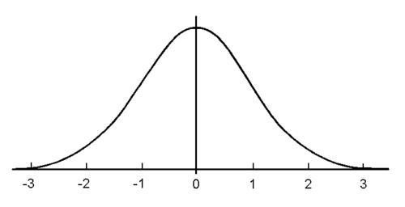



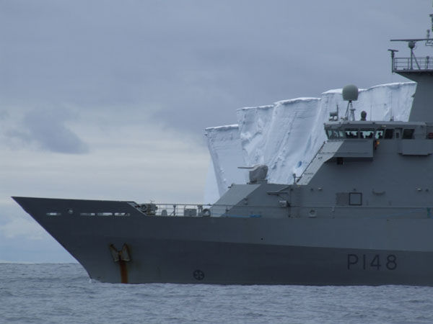
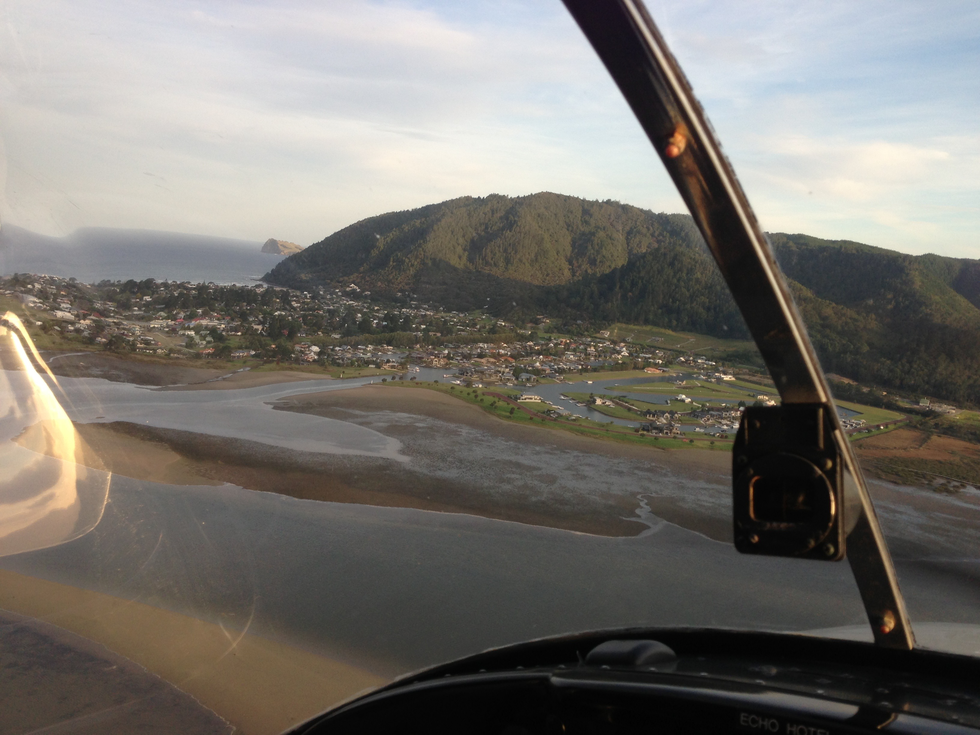
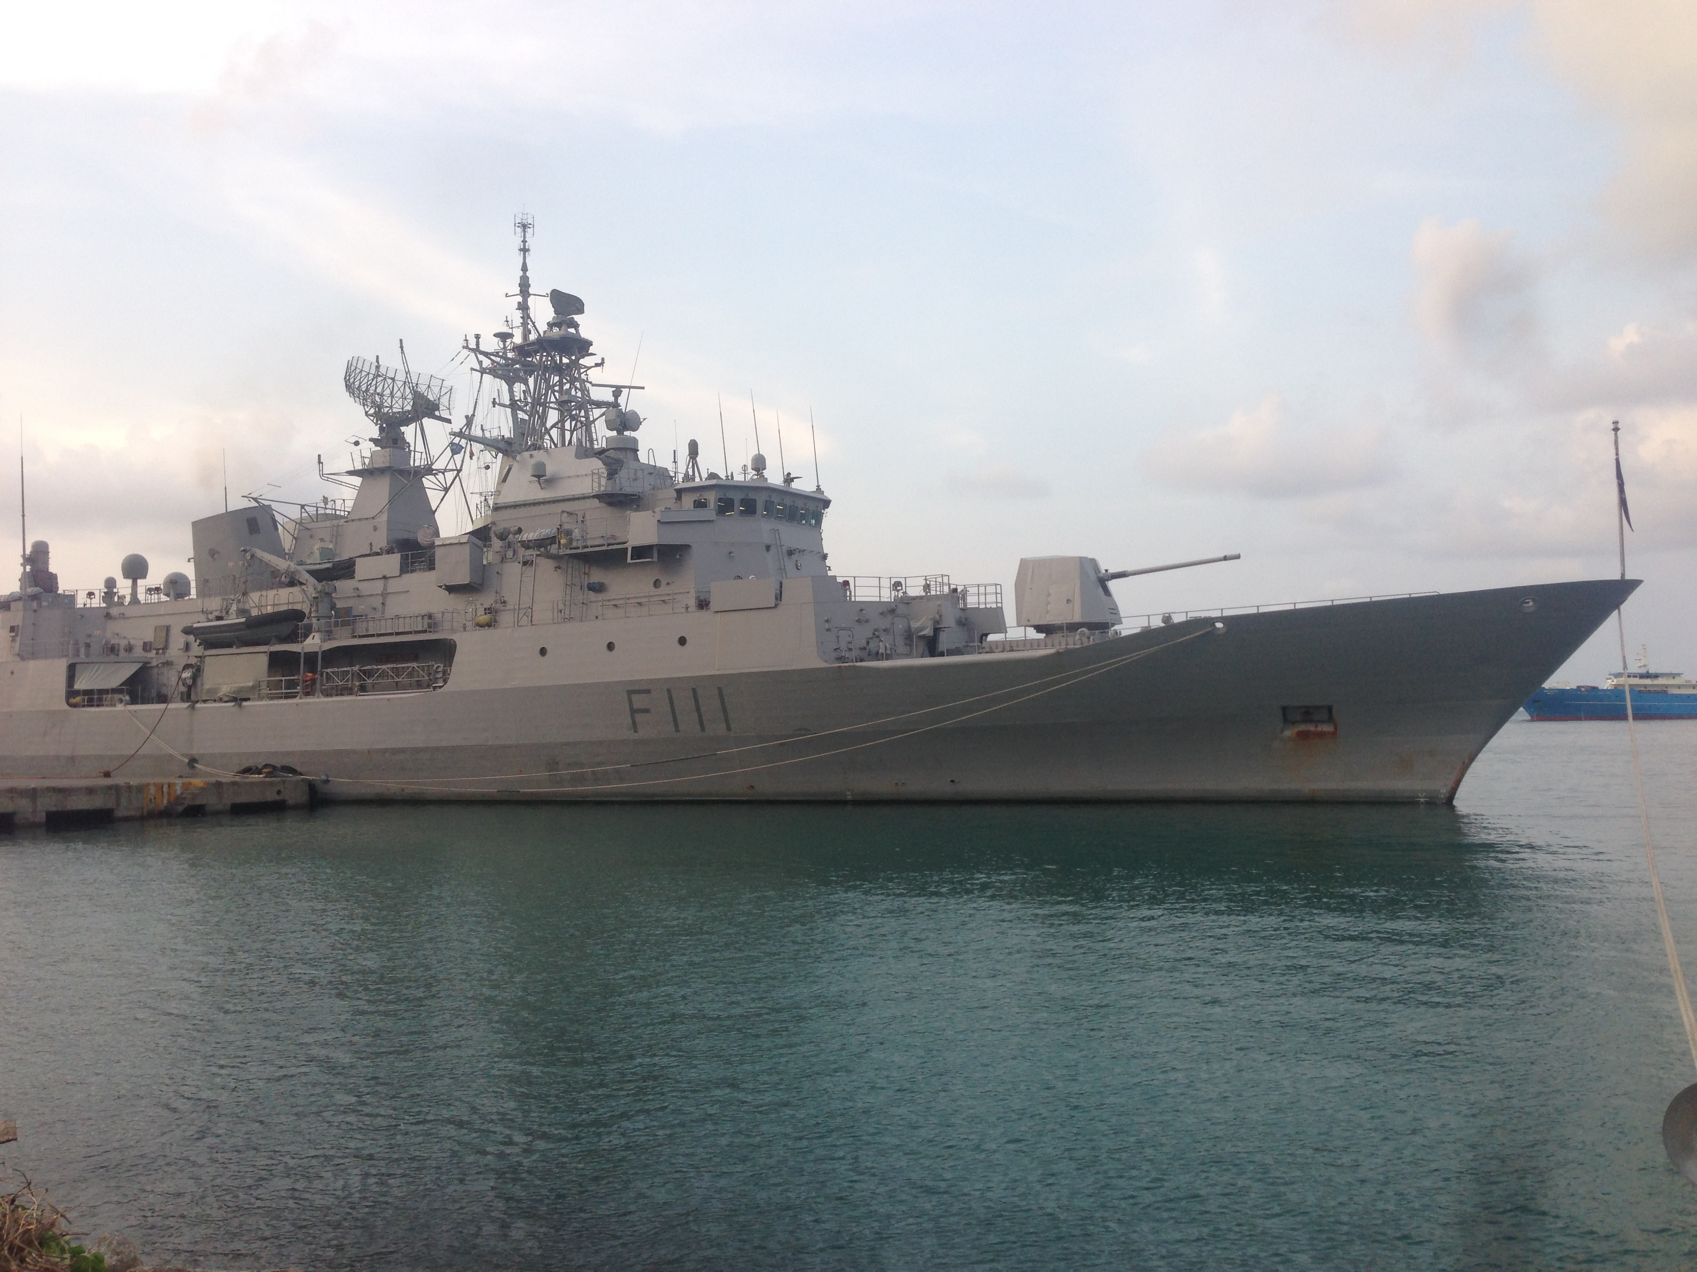
Background – Who am I?
Cognitive Psychology, Music History and Philosophy
PhD, MA, BA – University of Auckland, NZ
MSc in Organisational Psychology
Maastricht University
Pirate Hunter
Antarctic Explorer
Pilot
Warfare Officer, Navigator and Commanding Officer
Royal New Zealand Navy
Associate Professor
Maastricht University
Senior Human Factors Specialist at NATS
Human Performance Lead – Austro Control
Main topics: Leadership and Team Work in Safety systems, Human Performance, and Human Machine Interface Design

Slide 5

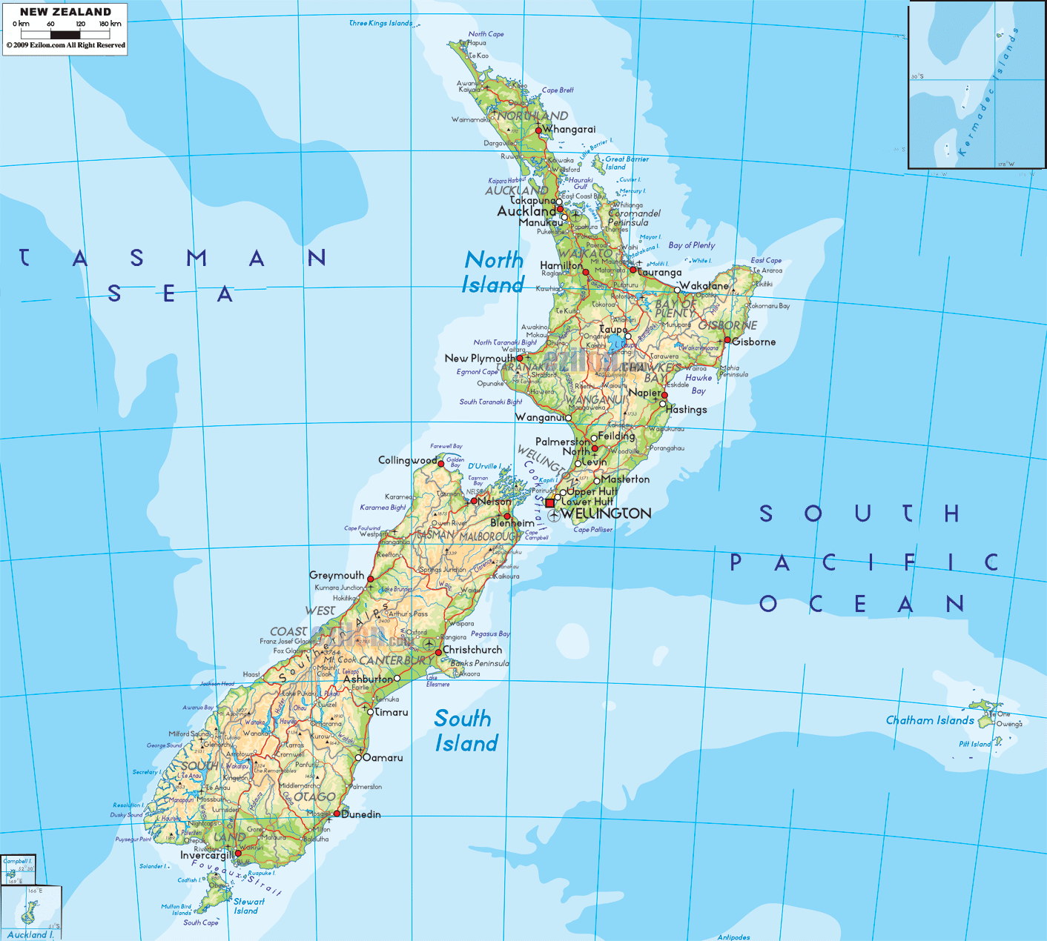


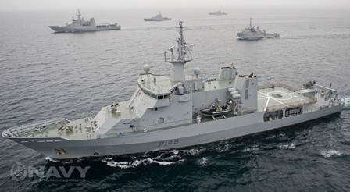
Where is home for you?
Born in Matamata (Hobbiton) to Dutch parents
Evicted for being too freakishly tall!
Now live in the United Kingdom
Reminder – NZ is here!!

Slide 6
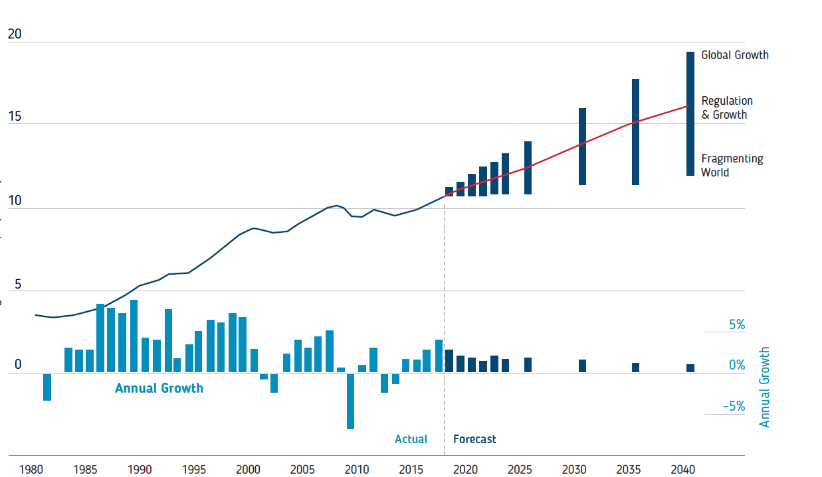
The problem statement
Even the most conservative figures have demand increasing. Delay is already in the system. Human Performance effects this greatly.
Growth of traffic currently outstrips supply of competent personnel to do the job. We are losing more people to retirement than we train to replace them and meet growth

Slide 7
The Balance...
According to a Mckinsey briefing in 2018, the Aerospace industry could see a 50 billion euro benefit from introducing more AI. Automation is included in this. More than 50% of activities (not jobs) could be automated.
Our workforce is changing dramatically. Other than pay, more employees demand flexibility above all else. Workforces change faster and demand more meaning
This demands a framework and understanding of automation on cognition
It demands an understanding of laying infrastructure and policy to meet the changing workforce

Slide 8
As capacity is pushed higher..
Safety and Human Performance are pushed to limits
Safety Decreases (not always linear – for illustrative purposes)
Human Performance surges to deliver full capacity but does not last long

Slide 9
Luckily, we know more and more about why
Human Performance has been long established as a key variable. Modern science continues to reveal more and more about why and how... Meaning we can take steps to improve..

Slide 10
LoAT Model – Automation Framework
The Levels of Automation Taxonomy is a four tier structure looking at:
    Information Acquisition
    Information Analysis
    Decision Making
    Action Implementation
It has been used successfully in a number of current SESAR projects as well as other areas of internal research
The model has demonstrated usefulness not only for framing discussions and identifying issues, but because quantifiable results can be captured from data in systems.
It has highlighted the Human Cognition elements as well
It can be used to look at ‘high-level’ operations in general but also is versatile to be used for individual technology and airspace projects

Slide 11






The automation areas make sense in terms of Cognition
Attention and Perception
Situation Awareness
Decision Making and Planning
Action Execution
Working / Short Term Memory
Long Term Memory
Adapted from Wickens, C.D., Engineering Psychology and Human Performance, Harper Collins, New York, 1992.
Notes:
MN / ML
Go through the answers

Slide 12
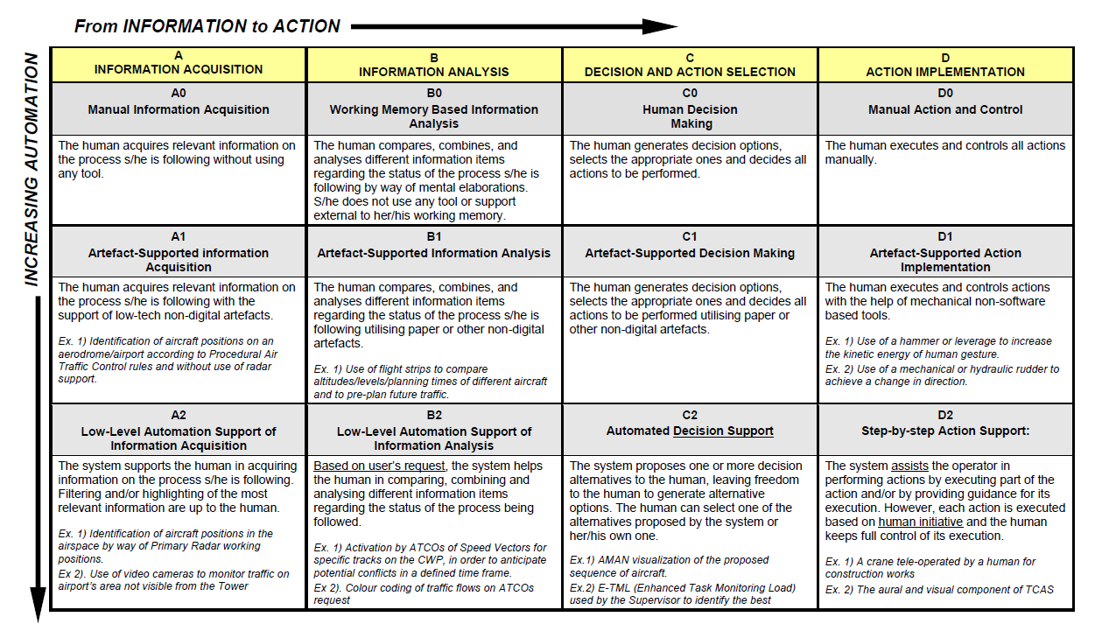

Slide 13
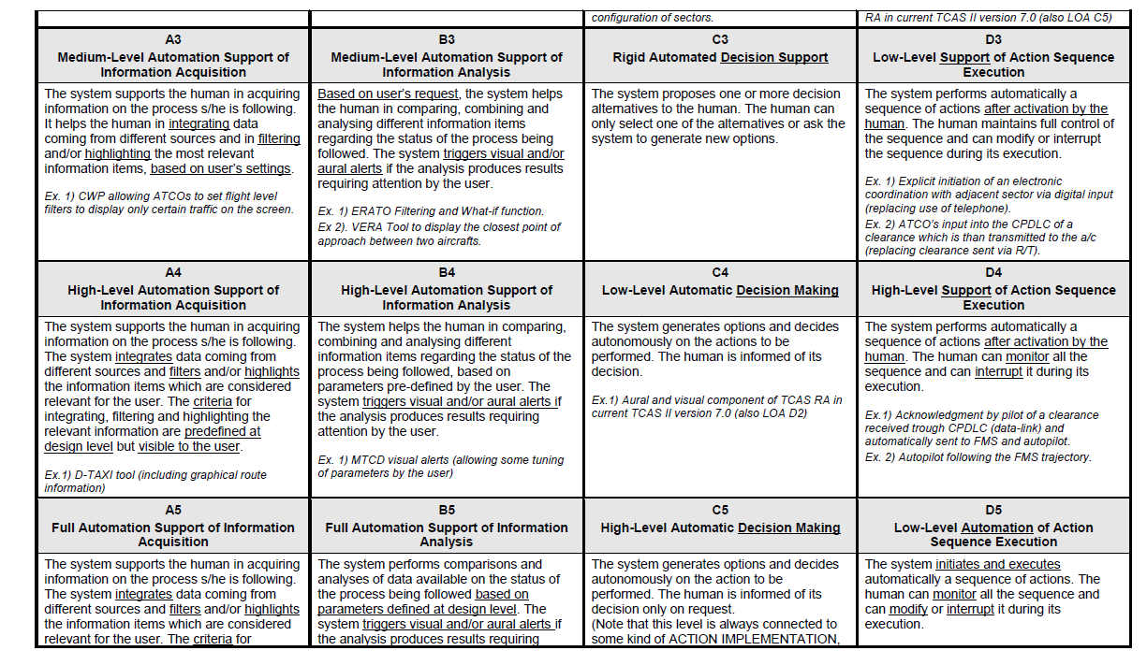

Slide 14
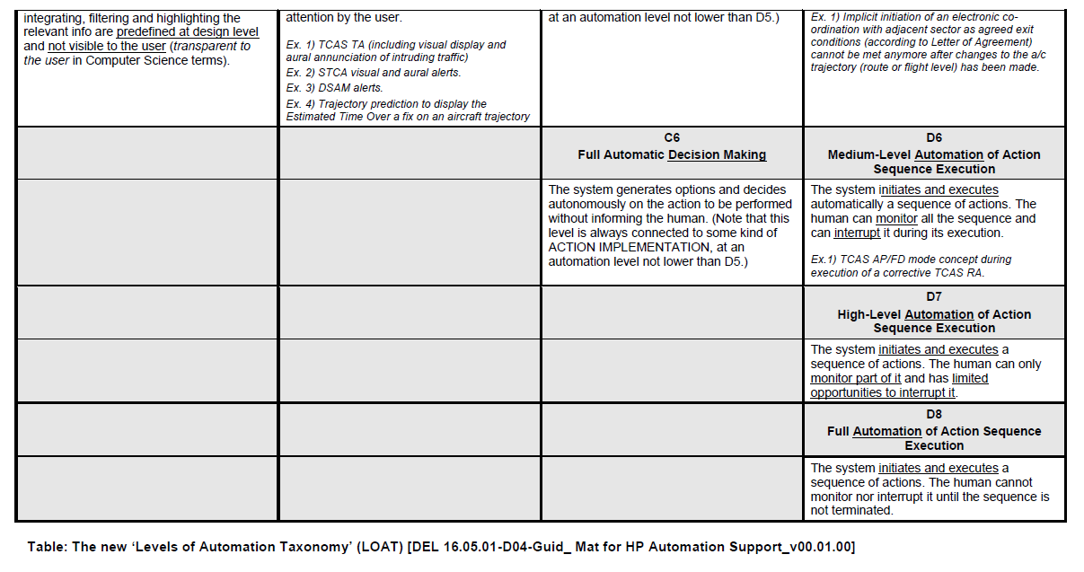

Slide 15
SESAR Human Performance (HP) Background
PJ10.02b: Advanced Separation Management: NATS addressed Systemised Airspace in the lower airspace and the need for automatic Non-Conformance and Resolution tools
PJ16.04: CWP HMI and in particular Multi-Touch and Speech Recognition support
Both areas have looked at levels of Automation in current environments and future states.
Recognition of a current ‘stasis’ and ‘end goal’ but warning over the transition to end goals, particularly for the human operators

Slide 16
PJ.10-02b Overview
- PJ10.02b investigates further steps towards a higher level of automation in separation management. It consists of advanced tools support for controllers, enabling increases in safety and capacity. The tools support the controller in monitoring tasks, show conflicting or dependent aircraft, proposing and selecting conflict free clearances.
- PJ10.02b has six different threads and environments. The NATS case focuses on systemised airspace proposals for the London TMA. This would see multiple simultaneous PBN routes bringing aircraft in and out to set points within the TMA.
LoAT was first used to map the current Operational (high-level view) with reference to tool support in general.
It was then used to look at what elements (levels) of separation management automated tools would be needed to deploy the solution. Controllers estimated that they would need to make a large leap from C2 to C5 and from D2 to D6 or above. This is a significant finding as it shows a key threshold that needs to be further researched. In this sense, the LoAT has been extremely useful at pointing out priorities for further research

Slide 17
PJ10.02b Case Study
A Standard SID out of Gatwick has 3-4 level offs.
This is due to Heathrow out bounds and Luton/Stanstead inbounds
Every level bust is crucial because of this.
Systemised airspace could see multiple simultaneous non-conformances
Controllers currently make a reaction in split seconds
Providing steps of automation may be too cumbersome
Thus, it will be ‘all or nothing’ and assurance will need to be greater than the current amount of Human Error

Slide 18
Moving through the levels
PJ10.01b – Modelling the Eurocontrol Automation Levels

Slide 19
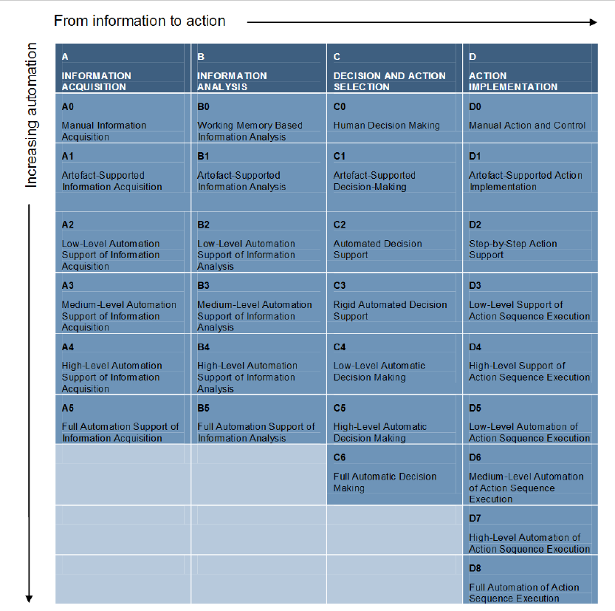
What does Automation have to do with it?

Slide 20

CANSO Standards of Excellence
Introduced in 2019, Austro Control took part as one of Six ANSPs to Test the model across the operations.
The SOE is now an international baseline and measurement tool for assessing HP Management and success

Slide 21

SoE in HPM
- results & proposed target levels
CANSO Standards of Excellence
Study Area | Element | Level 2019
1. | Policy, Strategy, Resources | B
2. | Health and Wellbeing | C
3. | ATM Equipment and Support Tools | C
4. | Operational Procedures | D
5. | Teamwork and Communication | C
6. | Operational Training | D
7. | Selection | D
8. | Impact of Change | B
9. | Leadership | A
10. | Roles and Responsibilities | B
11. | Human Performance Investigation and Learning | C
12. | Human Performance Management Assurance | A
Target level 2020
B
C
C
D
C
D
D
B
B
B
C
B
Target level 2021
C
D
D
D
D
D
D
C
C
C
D
C
2019 (12) | Level E | 0
 | Level D | 3
 | Level C | 4
 | Level B | 3
 | Level A | 2

Slide 22
Our HF strategy aims to integrate

Slide 23
Human Performance Strategy 2020 - 2030
Please contact Nathan directly to learn more – The Austro Control strategyy is not yet fully published and so not released here.

Slide 24
A short break
Summary so far:
Any research into human performance must be conscious of what it will take to shift an ANSP’s position. The Automation framework allows us to identify the correct element to tackle
A new tool or solution must be Safe and allow us to move between the levels safely without compromising efficiency and workload

Slide 25


Slide 26

What can Netflix teach us about HP?
Founded in 1997 as a Video order service
As late as 2007 this was the model then something changed
Began a streaming service 2008
Entered content production in 2012
By 2016 Netflix operates in 190 countries
2013 First Emmy award for House of Cards
By 2018 most nominated production company
2018 First Oscar
How did they do it??

Slide 27
Types of HP Measures
Cost is not just investment in technologies, it is also the human effort required to collect and process
Usefulness of course is variable and the right conditions must always be set for criterion validity

Slide 28
Types of HP Measures
Cost is not just investment in technologies, it is also the human effort required to collect and process
Usefulness of course is variable and the right conditions must always be set for criterion validity

Slide 29
For Reference – Existing HP Measures
 | WL | Stress | Fatigue | SA | Attention | Vigilance | Trust | Motivation | Viability Notes
Objective Measures
Echo Cardiogram (ACG) | X | X | X | X | X | X
EEG | X |  | X | X | X | X |  |  | Intrusive, much effort
EMG | X | X | X
EOG | X | X | X | X | X | X
fNRI | X |  |  | X | X |  |  |  | The collection of Health related data has been excluded by the project due to ethics permissions.
GSR/EDA | X | X | X
Respiratory | X | X | X
Eye Tracking | X | X | X | X | X |  |  |  | May have medium accuracy
Ergonomic Measures (ISO Standards – e.g. Rapid Upper Limb Assessment) |  | X | X
Seat Sensors | X | X
Voice Analysis | X | X |  | X
Mouse Clicks / Tracking | X |  |  | X | X | X |  |  | Easy to log
Keyboard Strokes | X |  |  | X | X |  |  |  | Easy to log
Reaction Times | X | X | X | X | X | X | X |  | Start and end time of reaction sometimes hard to identify (thinking)
Subjective:
User Acceptance (perceived acceptability) | X | X | X | X | X | X | X | X
Bedford Workload Index | X | X
NASA Task Load Index | X |  |  |  |  |  |  |  | Often Used, therefore good comparability
China Lakes SA Measure |  |  |  | X
Picture Scale Measures |  |  |  | X
Instantaneous Self-Assessment | X | X | X | X | X | X | X | X | Quick and Easy Method
Eurocontrol SHAPE questionnaires (e.g. SASHA and SATI) (11 and 12) | X |  |  | X |  |  | X
Expert Observations (over the shoulder) | X | X | X | X | X |  |  | X
Situational Awareness Rating Technique |  |  |  | X | X
Situational Awareness Global Assessment Technique (SAGAT) |  |  |  | X | X |  |  |  | Intrusive

Slide 30
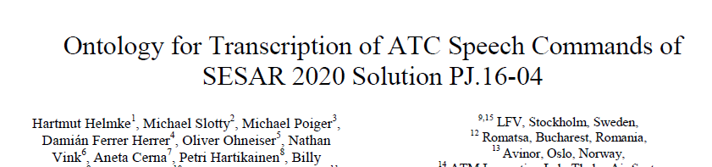
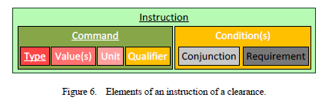
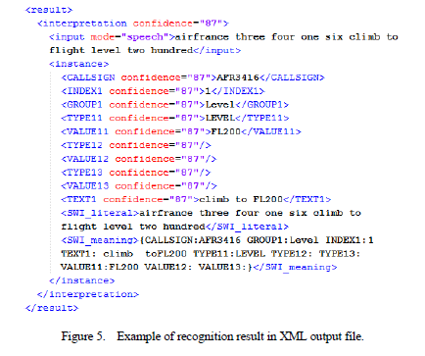
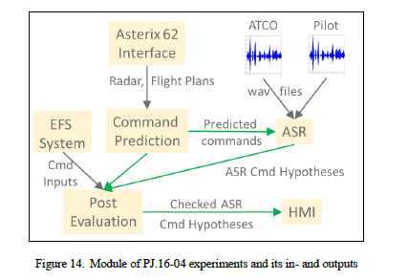
The Ontology

Slide 31
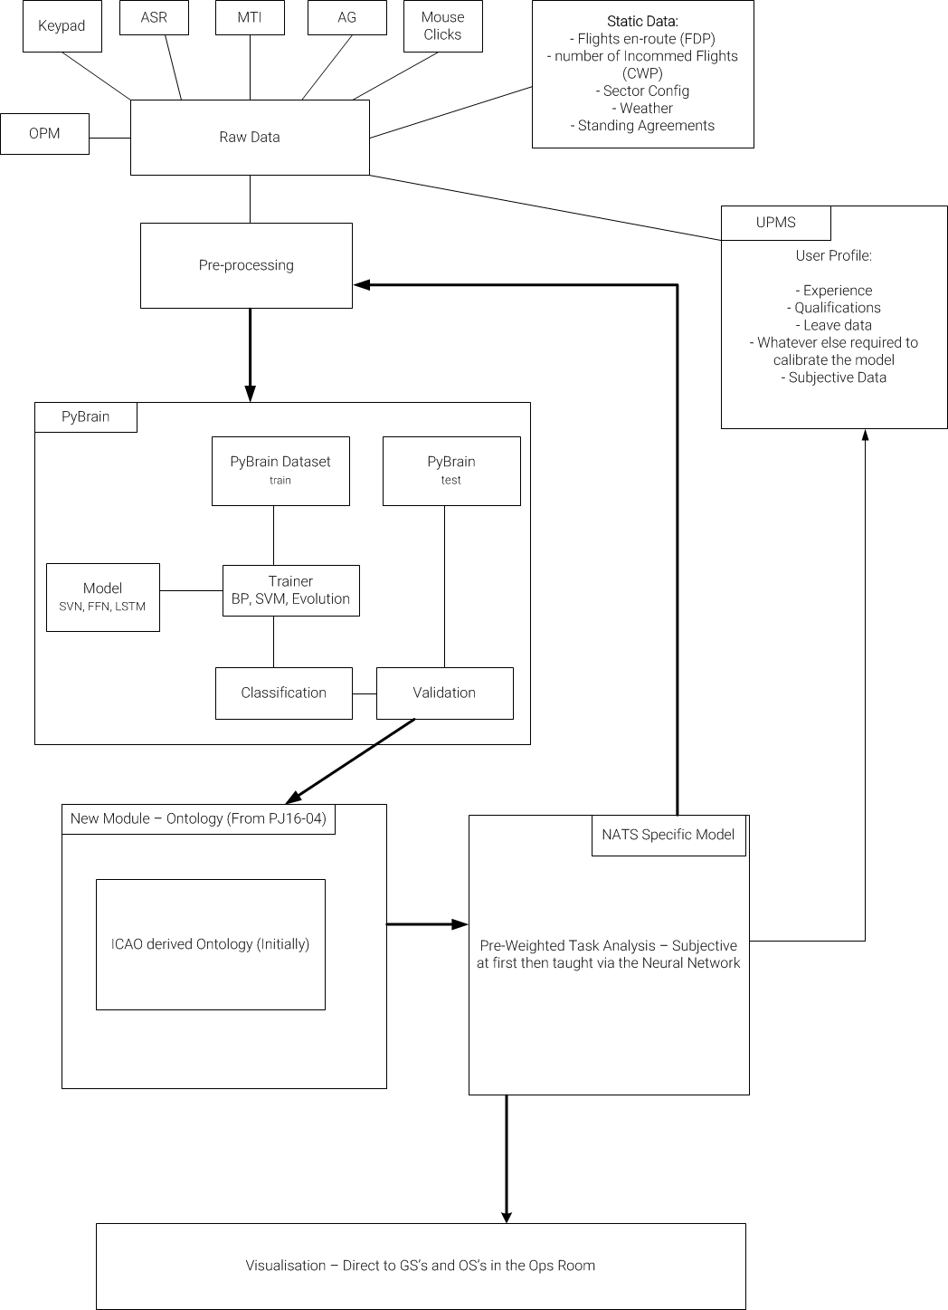
The Algorithm
Raw Data (from Systems)
Static Data (from other systems)
UPMS Component: a side story
Pre-processing: the hardest part!
The Neural Network: looking for correlations
The Ontology: Identifying what it all means
The TA (subjective at first): deciding what busy is
Visualisation: Giving it to those who need it
Machine Learning: learning from outcomes

Slide 32
In More Details

Slide 33
How it Works

Slide 34
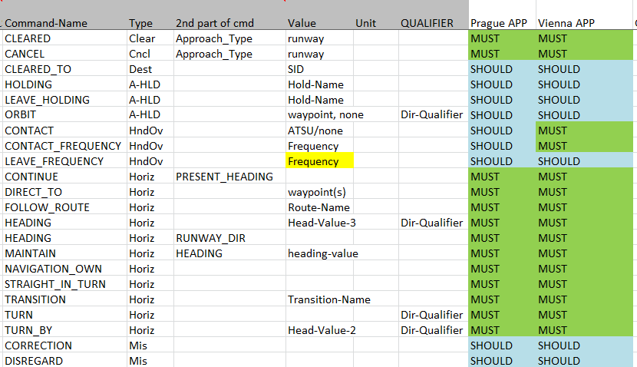
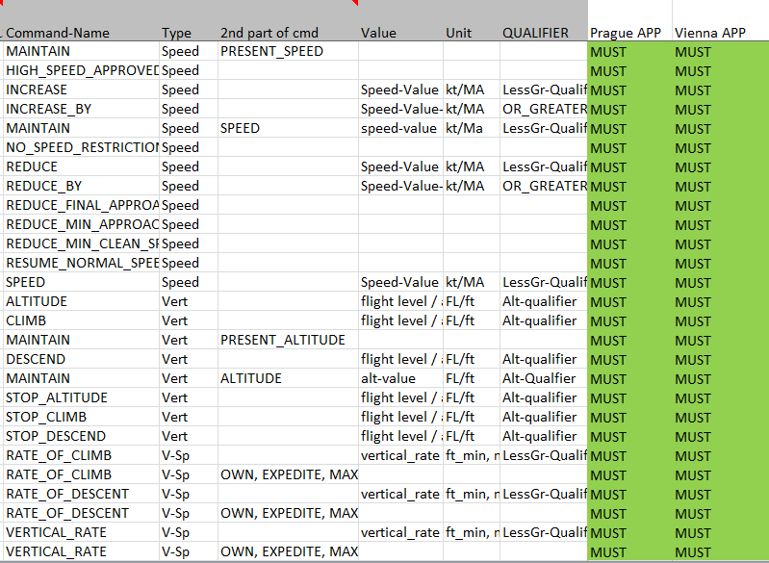
An Example of all the types of tasks
Taken from Vienna and Prague Approach Ontology – PJ16.04

Slide 35
Of course its not just about machine interactions...
The examples show how the basis of the Ontology began with ‘known’ human-machine interractions
But... A lot of cognitions are not represented by machine interactions...
This is where you have two options:
  Interviews and task analysis reveal the ‘thinking’ workload as subjectively measured
    E.g. What to do in a non-conformance
  The black-hole Halo: i.e. Using Machine Learning to infer the cognition time
    This will be the next step in development
    We already have data on this

Slide 36
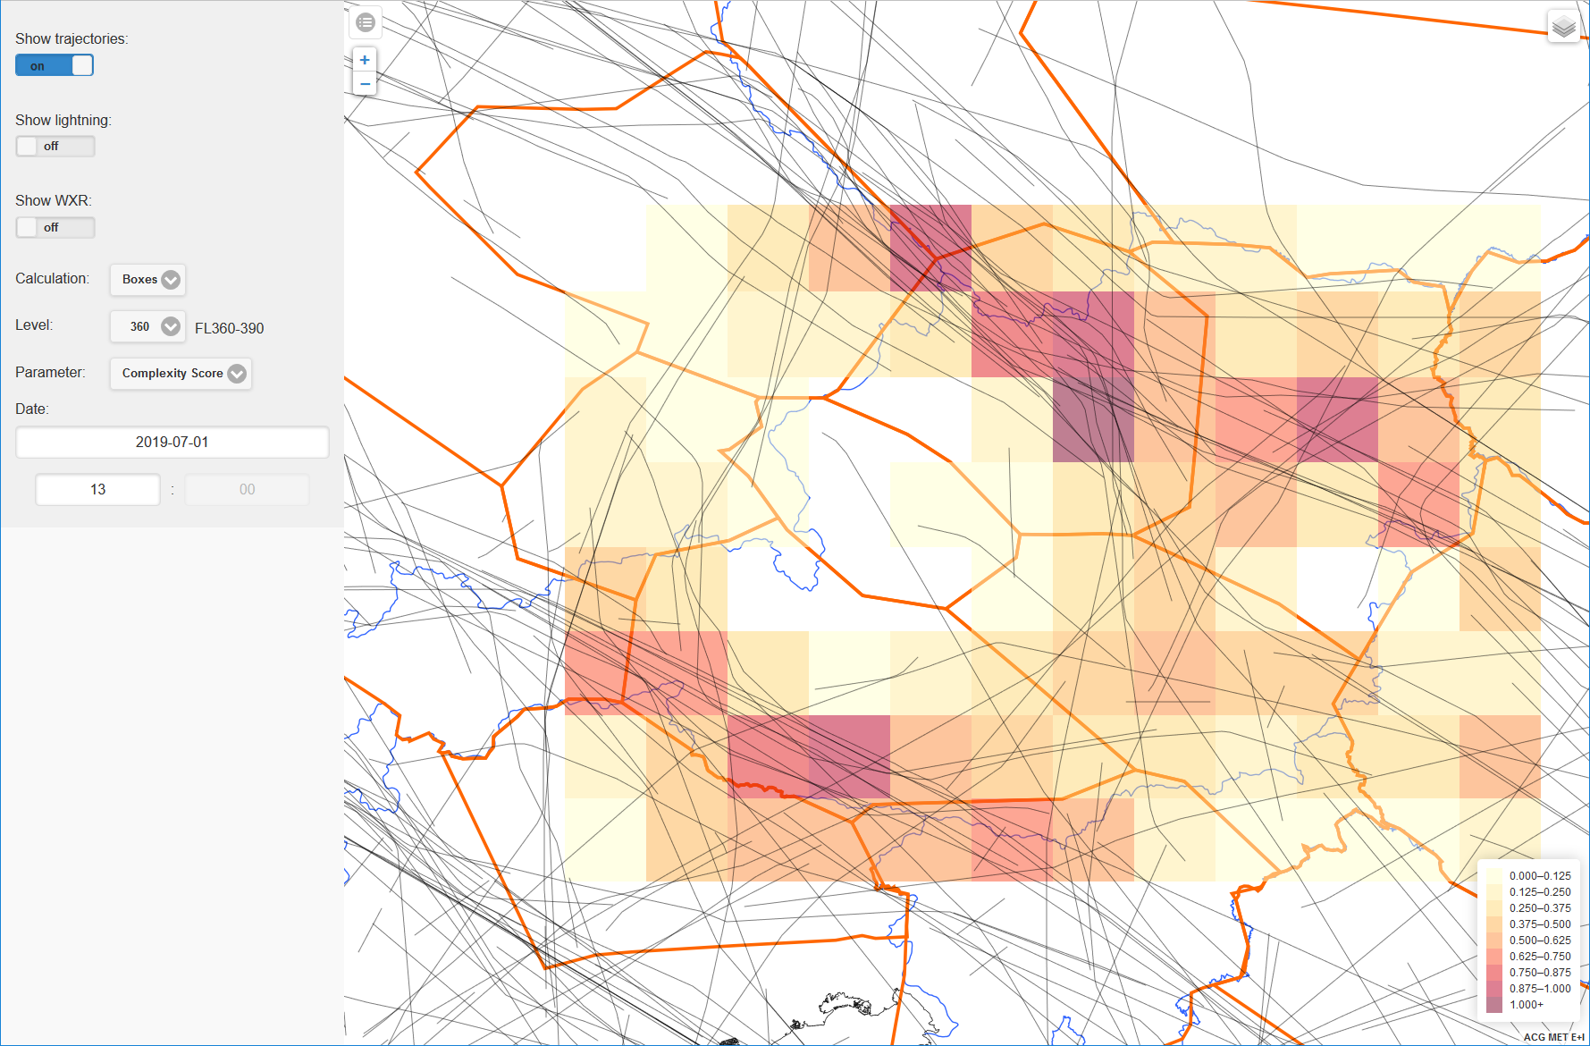
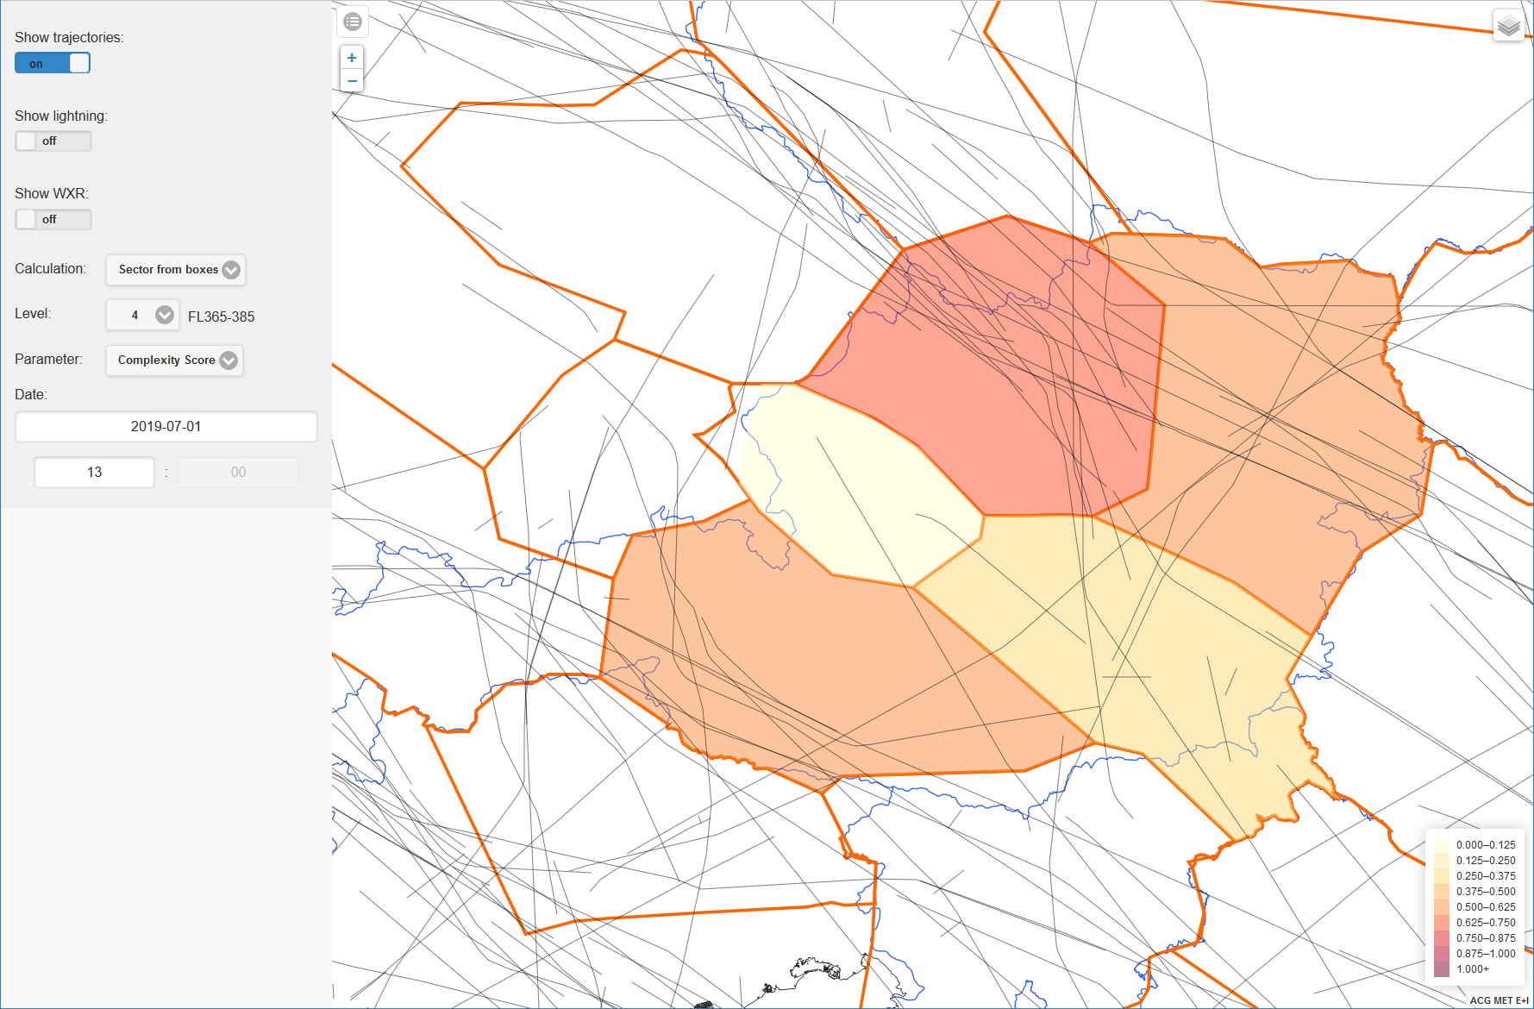
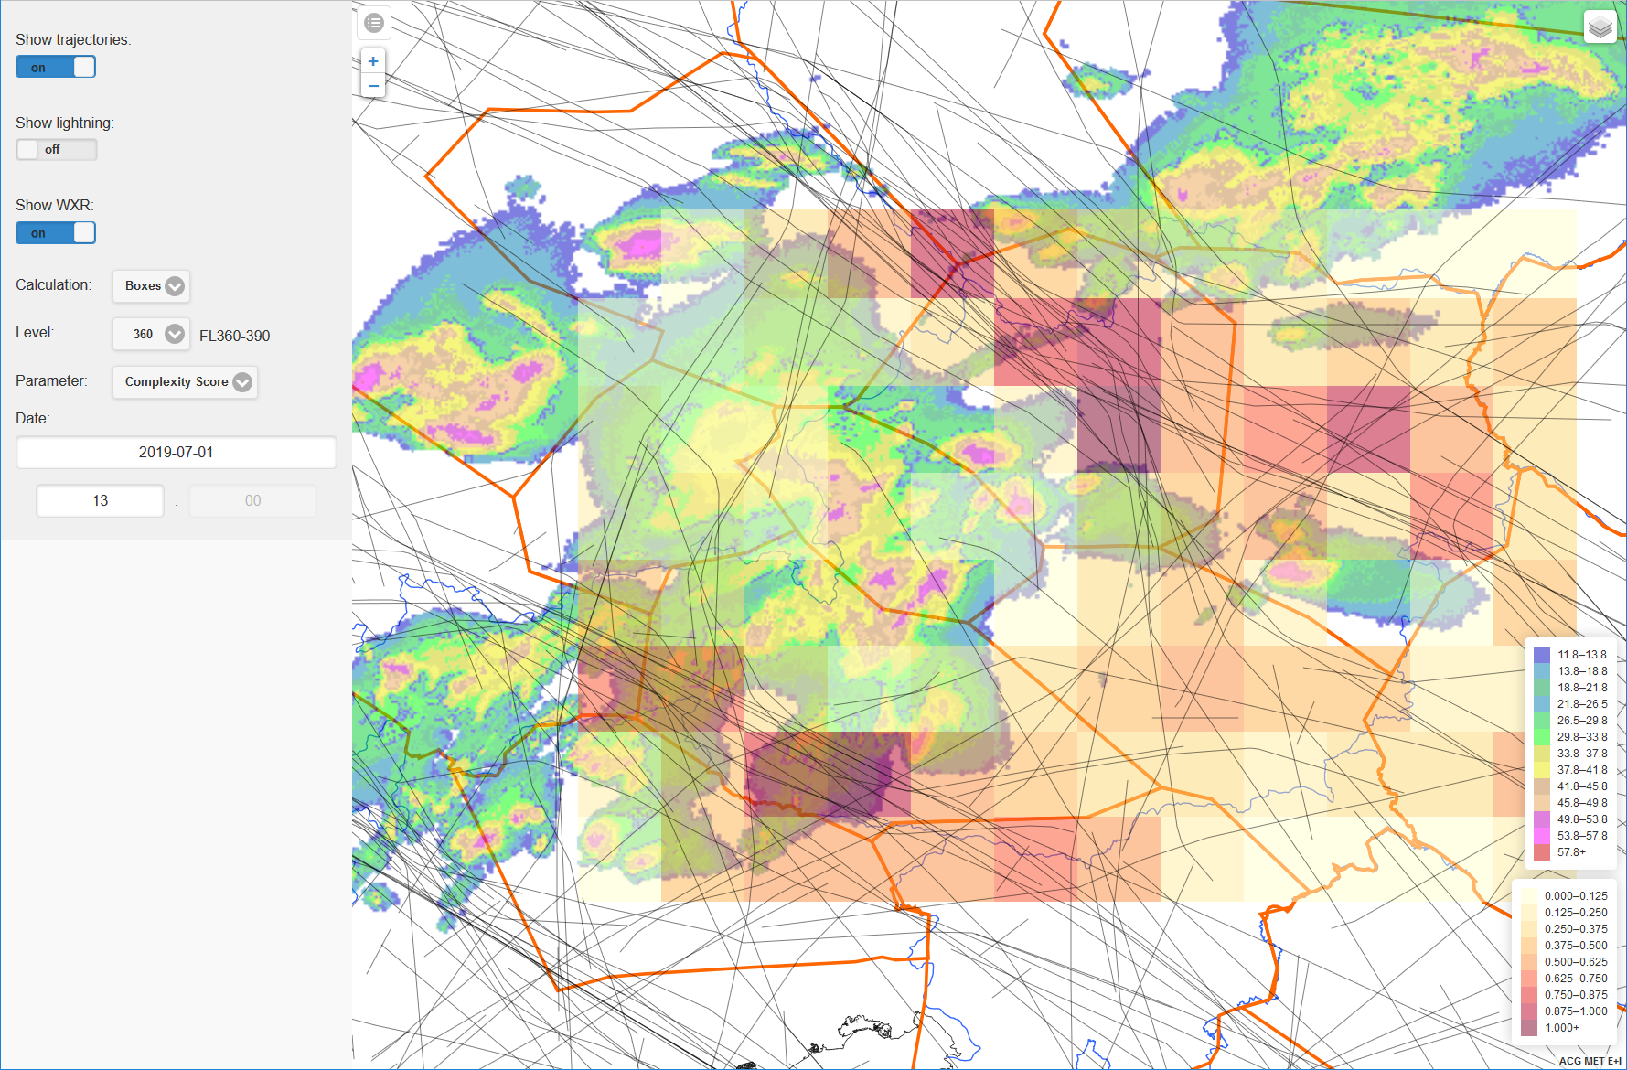
Link to Complexity and MET
Austro Control has projects for Complexity and MET. When HP is overlayed, the power for Supervisors and Operational decision making is further enhanced...
For Boxes (20 nm x 20 nm x 3000 ft x 1h):
For sectors:
Combined with weather:

Slide 37
Results – Sector specific capacity tables

Slide 38
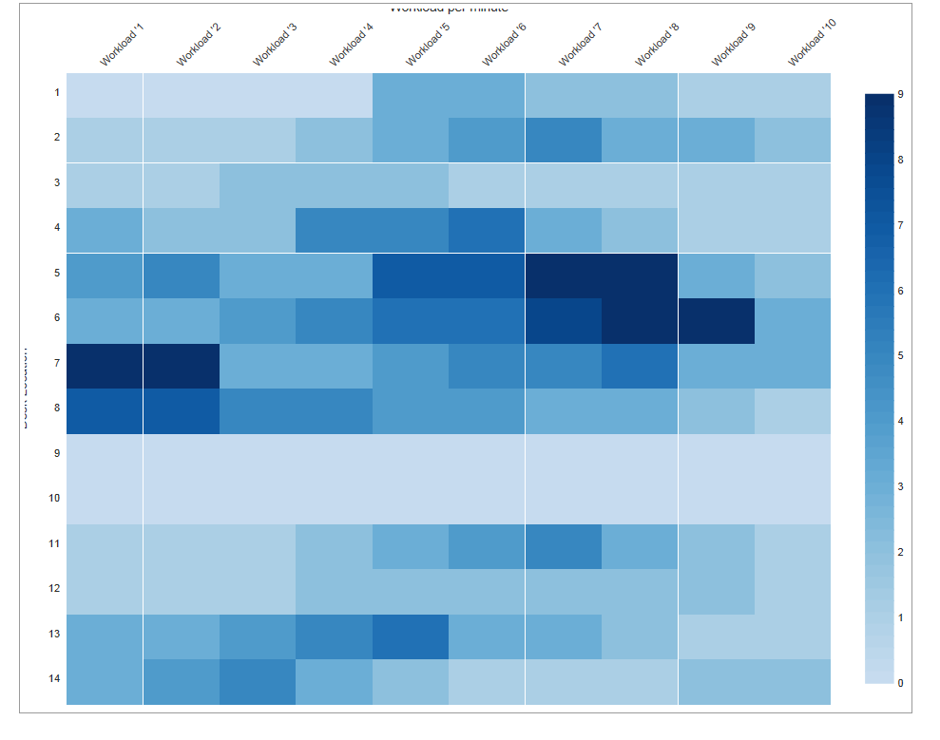
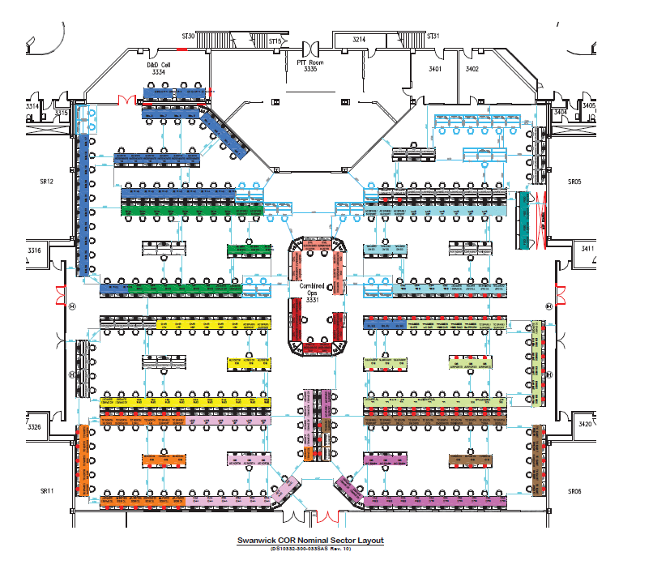
Real time workload for Supervisors
Real time workload per minute (or finer if necessary)
Improved decision making by GS and OS
Best practice MOPs identification
Validation of technology projects for usability, acceptability, WL and SA

Slide 39
Link to Complexity and MET
Austro Control has projects for Complexity and MET. When HP is overlayed, the power for Supervisors and Operational decision making is further enhanced...
For Boxes (20 nm x 20 nm x 3000 ft x 1h):
For sectors:
Combined with weather:
For Illustrative purposes so far...

Slide 40
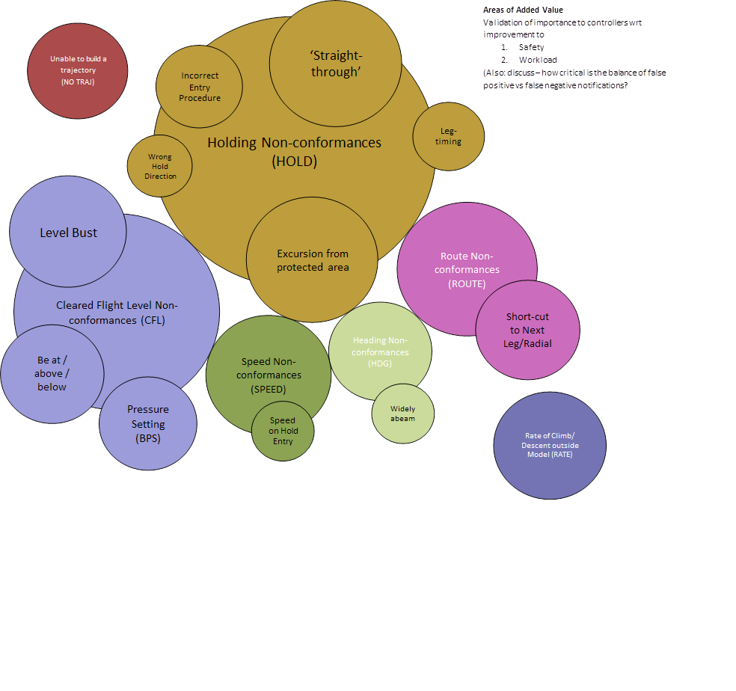
Design and Assurance assistance
Priorities for Automatic Non-Conformance tools
Notes:
Current objective data indicates where the most common non-conformances are occurring and thus would set the priorities for what information needs to be more automated in a systemised airspace environment

Slide 41
Longer Term Implications and Next Steps
Computer generated job descriptions
Pinpoint human error
Better design decisions on HMI, Automation and traffic capacity
Computer generated ‘optimal airpsace’ designs based on Human Performance
Safe and Controlled implementation of new technologies and automation
Individual analysis for training, occurrences and general human performance
Outside of ANS – enhanced understanding of general cognition in Human Beings
Support for the Cumulative Prospet Theory and Systems 1 and 2 thinking of Daniel Kahneman

Slide 42
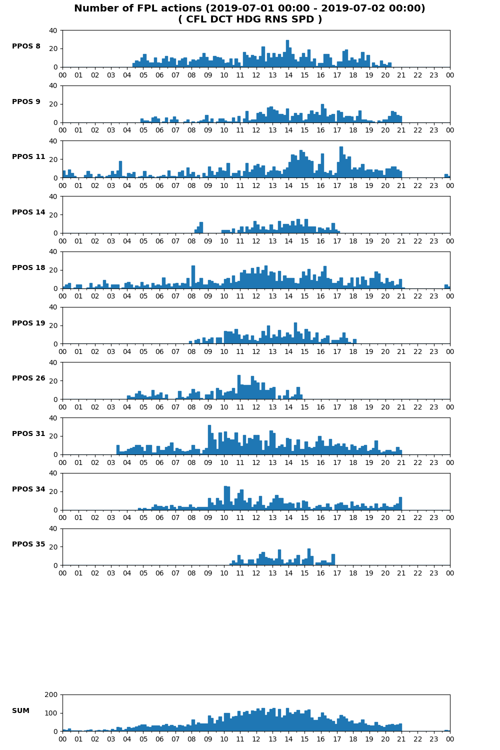
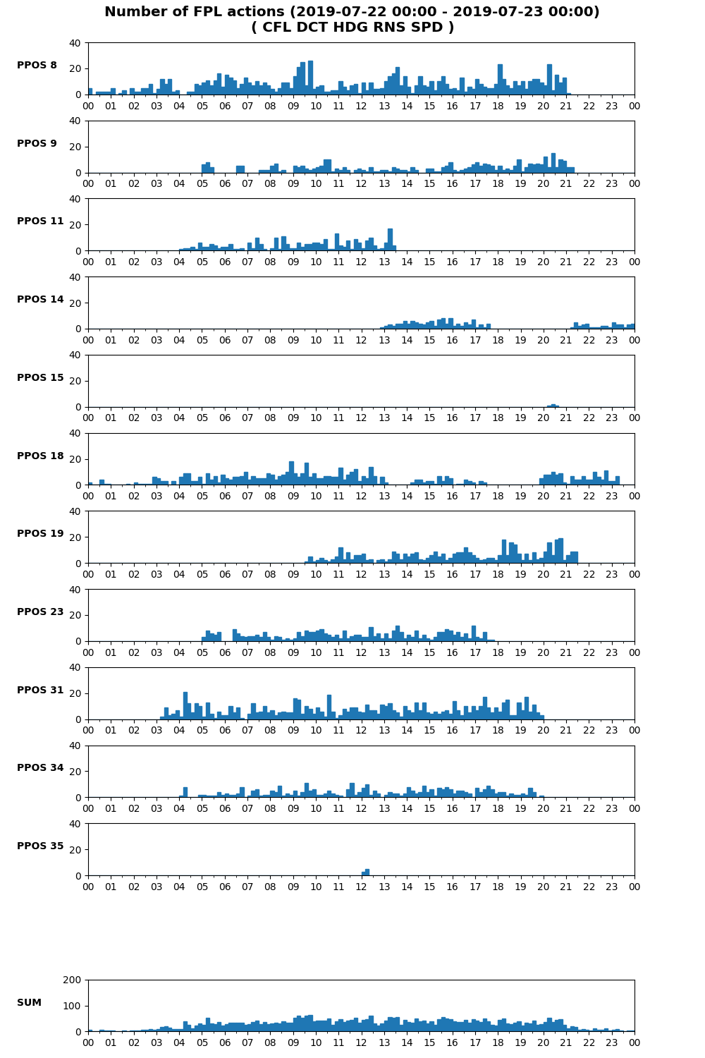
Next Steps – Integration and Infrastructure

Slide 43
Facilitating Research and Links
HAWAII SESAR ER4 Bid
SESAR Wave 2 PJ10 Sln 96 – Continuation of PJ16.04 on Speech recognition, eye tracking and user profiles
Digital ANS work in COOPANs)
Eurocontrol Scientific Community on Automation
CANSO Human Performance Standards
Link to Austrocontrol Heading 030, Human Performance Strategy/Campaign and Assurance enhancements

Slide 44
Obstacles
Need to get more data! ☺
Strategy and infrastructure for extracting meaningful data
‘Smarter’ workstation designs
Validation and safety cases for making decisions based on this kind of data
Potential Privacy concerns – should be alleviated by ‘system’ view rather than ‘individual’ view
Industry partners to change their approach to system development – e.g. some core code changes to Topsky

Slide 45
Danke Schön und Liebe Grüße!
Questions? Fragen? Frågor?
For more information please do get in touch:
Nathan.vink@austrocontrol.at
Linkedin: nathanvink

