Slide 1
Seamless Nowcasting System Development at the Finnish Meteorological Institute (ULJAS)
J. Nuottokari, E. Gregow, H. Hohti, J. Kotro, I. Karjalainen, J. Ylhäisi, L. Hieta, M. Partio & J. Karjalainen

Slide 2
Outline
Background for FMI Nowcasting System development
Design of the project and components
Work Packages
Results
Conclusions

Slide 3
1. Motivation
Over the years, FMI has developed individual nowcasting solutions serving specific needs, but we have been lacking a comprehensive nowcasting system
The 0-6h nowcasts are largely produced manually
The current way of working does not meet all of our customers’ needs and is not updated quickly enough for automatic production processes
Data is in siloes and not in a uniform database

Slide 4
2. Project Design
Vision FMI nowcasting system represents international state-of-the-art and generates added value to our customers. Societal impact is achieved by applying open data policies.
Goal Seamless and automatic forecast production process in the 0-6h timeframe by the end of 2019 in the Nordic domain*
*extended Scandinavia+Finland

Slide 5
2. Objectives
Combine various observation and analysis data sources into an accurate current state of the atmosphere
Implement a rapidly updating limited area nowcasting NWP model over the Nordic domain
Implement radar and satellite based nowcasting products into operational production
Blend observations, nowcasting products and NWP data into a seamless forecast
Implement continuous quality control and assurance of the nowcasting information
Develop and implement necessary changes to the production system

Slide 6
WP1 Implement weather radar based observation and nowcasting for precipitation fields
  Precipitation motion field analysis
  Implementation of the FMI Probabilistic Precipitation Nowcasting (PPN) method
  Blending of the precipitation field with the nowcast NWP fields
  Development of the operational production environment
  Verification
Notes:
Snow nowcasting also called snowcasting. Very relevant in the Nordic in winter time.

Slide 7
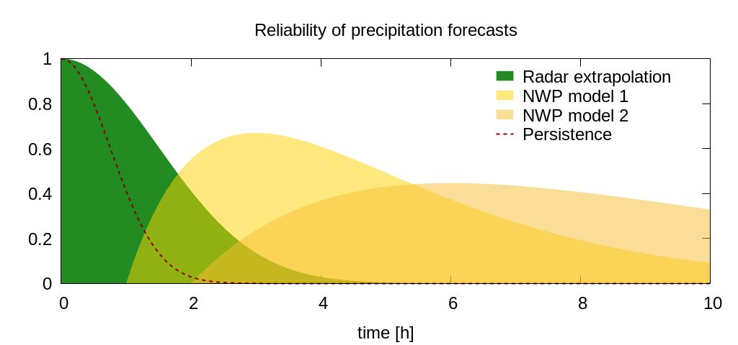
Working hypothesis:
Up to 1-2 hours, weather radar based direct motion extrapolation is
superior to model based forecasts
Nowcast model
Numerical model
Total reliability
D/E | B/ C | A
A | B/C | D/E
Notes:
Seamless integration of different data sources is needed. In order to obtain the best possible reliability for example for a precipitation forecast.

Slide 8
WP2 Hazardous weather object nowcast
  Convective weather objects identification implementation
  Implement trajectory and probability calculation for objects
  Validate compliance with radar-based methods
  Extrapolation of information from additional data sources (lightning, satellite, emergency calls, crowdsourcing, etc.)
  Verification and operational production
  Visualisation of objects in customer products

Slide 9
WP3 Enhanced mesoscale analysis system
  Extending analysis area to match nowcast NWP domain
  Using HARMONIE control run as baseline for LAPS analysis
  LAPS version update
  LAPS resolution increase to 2.5km and new projection
  Implement 3D LAPS analysis
  Intercomparison between MET.no and LAPS analysis methods
Notes:
Quickly, not very interesting to snowcasting.

Slide 10
WP4 Implement satellite-based nowcast methods
  Reliability analysis for meteorological variables generated from satellite sources
  Development of file conversions
  Operational satellite nowcast production
  Verification

Slide 11
WP5 Development and implementation of the MetCoOp HARMONIE-Nowcast (MNWC) model
  MetCoOp HARMONIE-Nowcast model development
  Implement MNWC cloud correction and analysis method
  Improvements in the MNWC data assimilation methods
  Verification of model output

Slide 12
WP6 Observation and model data blend and quality assurance
  Development of blending algorithms and operational implementation
  Seamless blend of different temporal forecasts from 0h to 3d
  Quality assurance of interdependencies between meteorological variables
  Verification

Slide 13
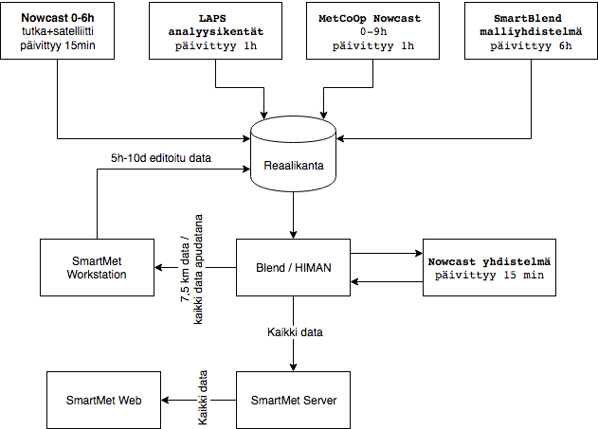
WP7 Production system development
  Operational implementation of data fusion in the real-time database
  GRIB support to FMI SmartMet Server
  Modification of models to use blended data
  Modification of production to generate products from blended data
  Implementation of nowcast data to forecaster workstations
  Quality control and assurance
Notes:
Show only very briefly! I am not a very technical person so it is hard to explain this slide for you. But the main idea is that we are aiming that all the data will be in machine readable format i.e. digital data. For other autonomous systems to start reading it and process it as best seen.

Slide 14
WP8 Collection and quality control of crowdsourced weather data
  Collection of observations from NetAtmo stations
  Implement quality control based on MET.no TITAN software
  Development of quality control algorithms for FMI data sources

Slide 15
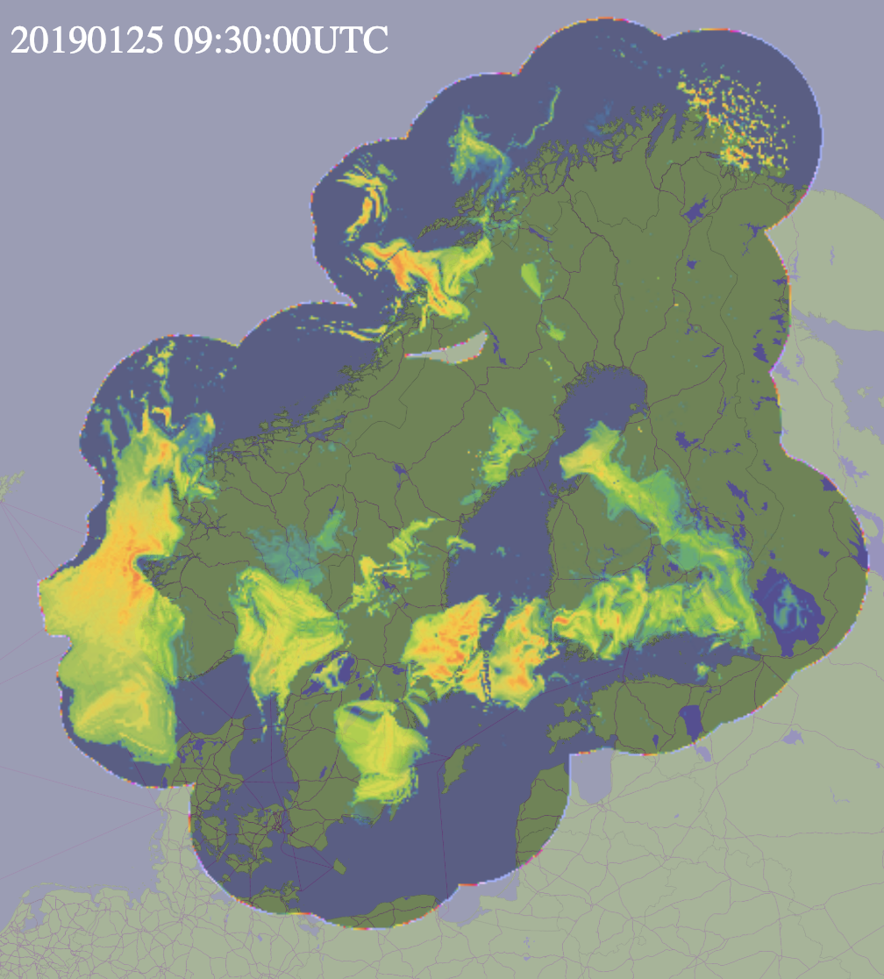
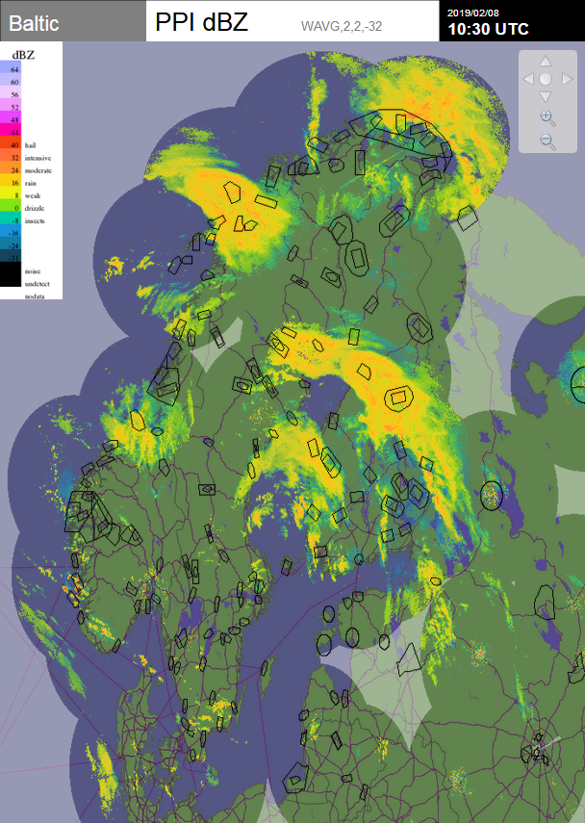
WP1 Radar extrapolated nowcast
Domain: as in image
Timescale: 0-2 h
Notes:
WP1: show also ilmailusaa.fi tuliset demonstration

Slide 16
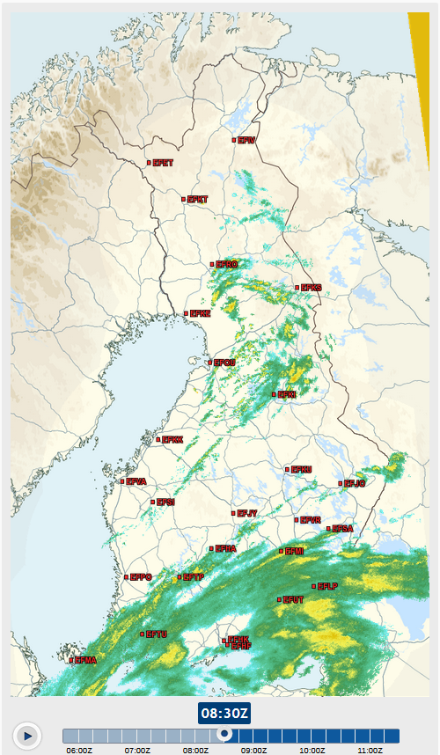
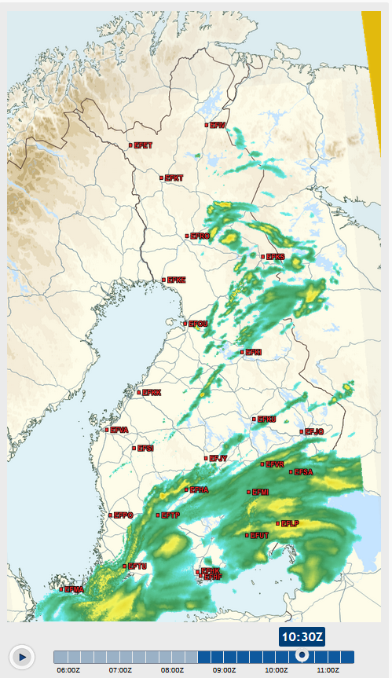
Notes:
Show if ilmailusaa.fi is not working or if no meaningfull precipitation is not on the map.

Slide 17
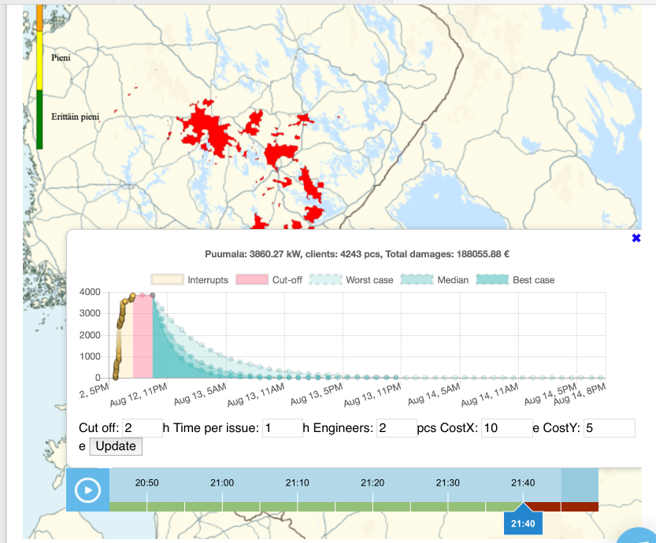
WP2 Hazardous weather objects
Electrical power outages due to severe wind gusts, downburst produced by a rapidly moving mesoscale convective system
Notes:
Example on WP2 hazardous objects

Slide 18
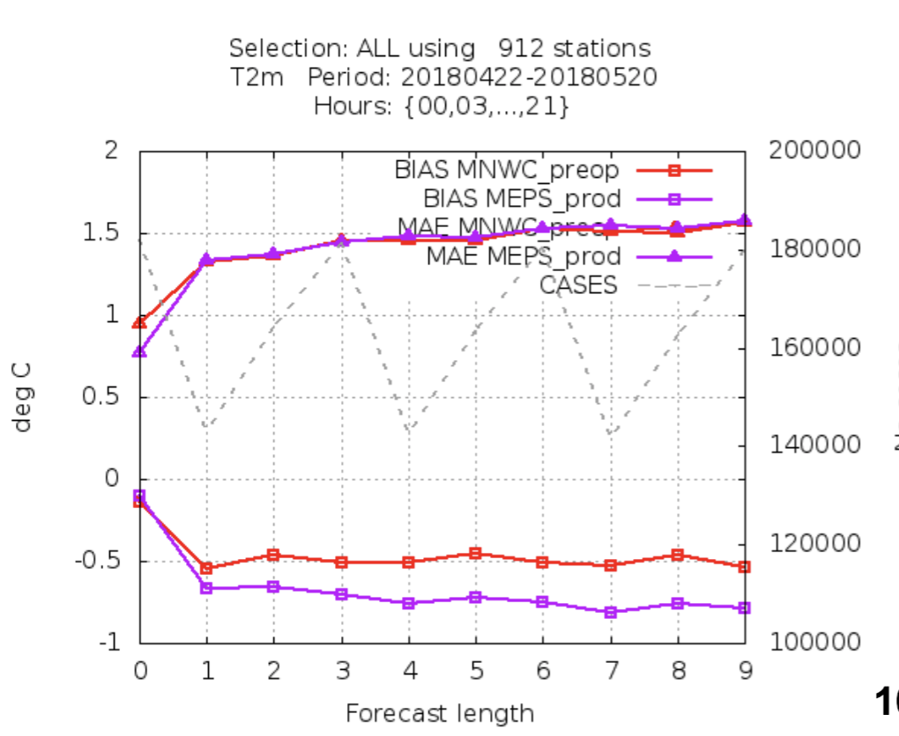
WP5 MNWC
Improvements in verification scores for most surface meteorological variables
Still a need for improvements if the meteorological analysis field, but better (nowcast) forecast than HARMONIE control run
Notes:
Example WP5

Slide 19
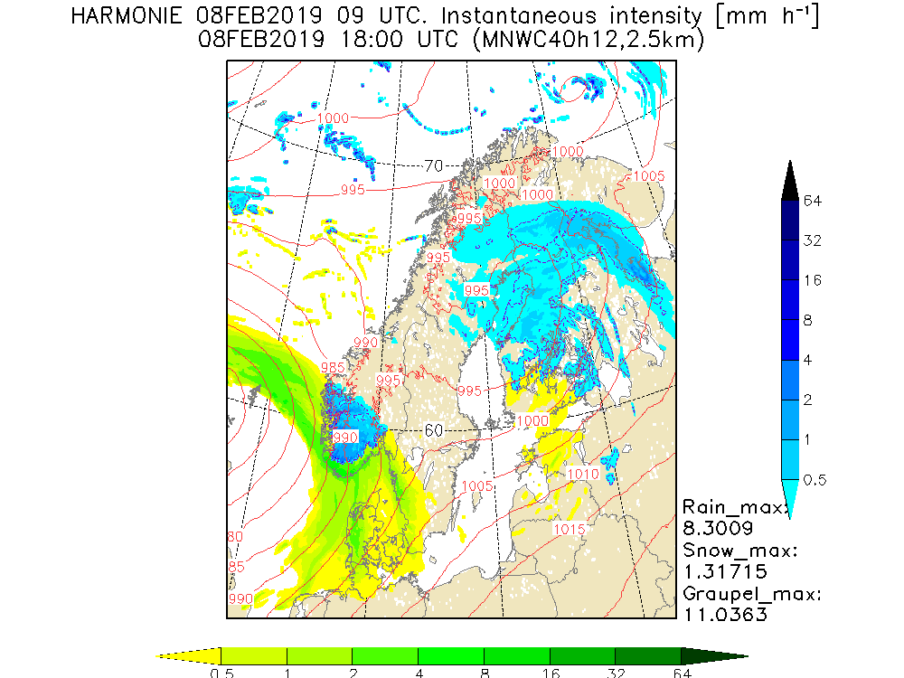
WP5 Nowcast model
Domain: as in image
Timescale: 2-6 h

Slide 20
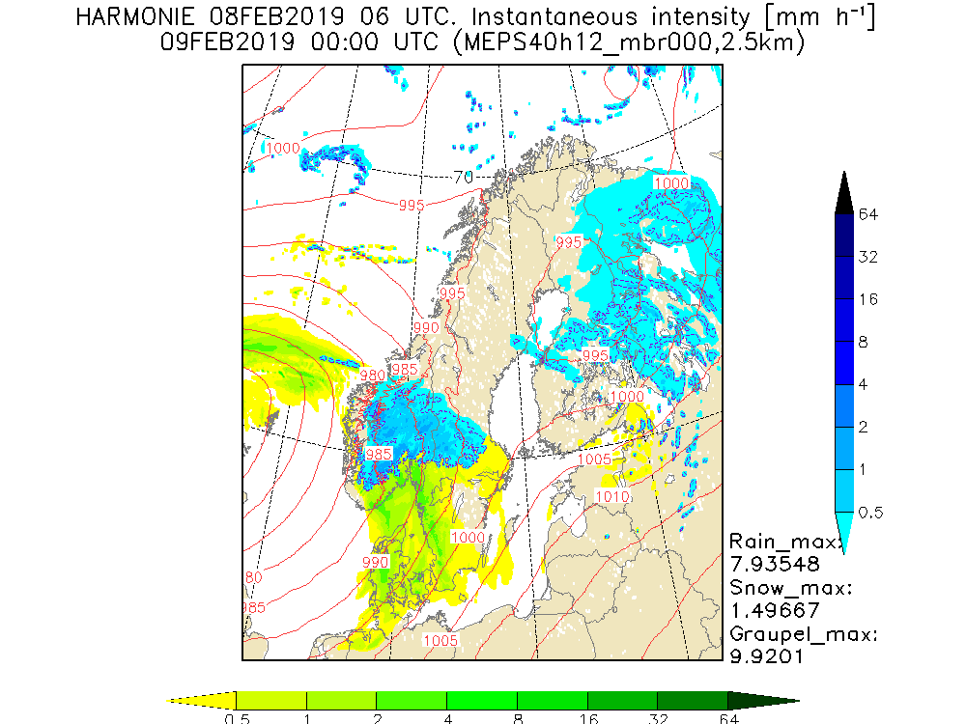
WP6 Numerical weather prediction (NWP) model, data blend
Domain:
  Limited area model as in image
  Global model: the whole globe
Timescale:
  Limited area: 6 h – 2½ days
  Global model: 2 – 10 days

Slide 21
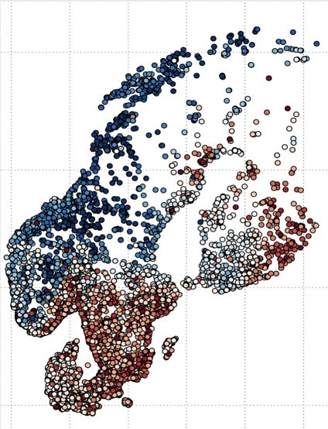
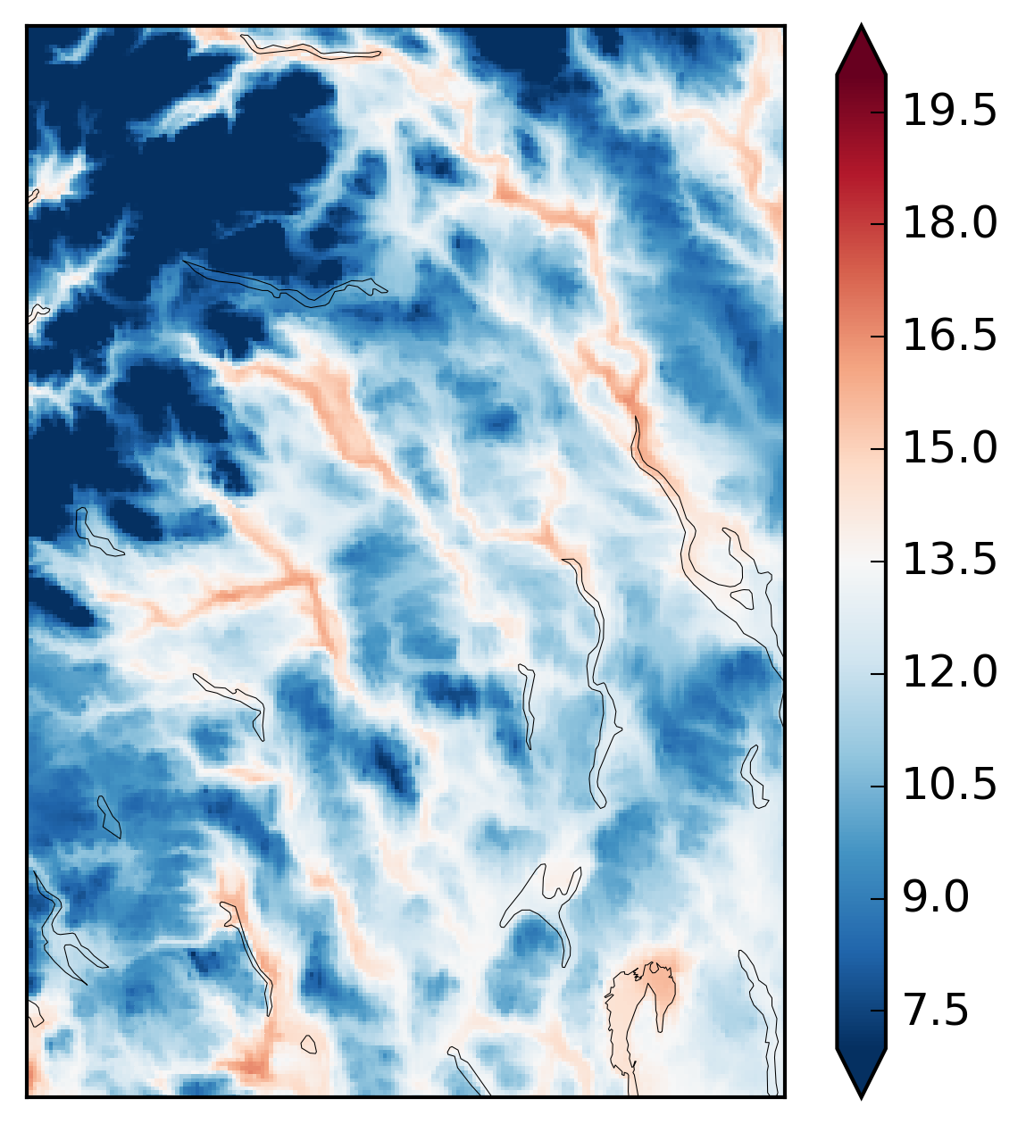
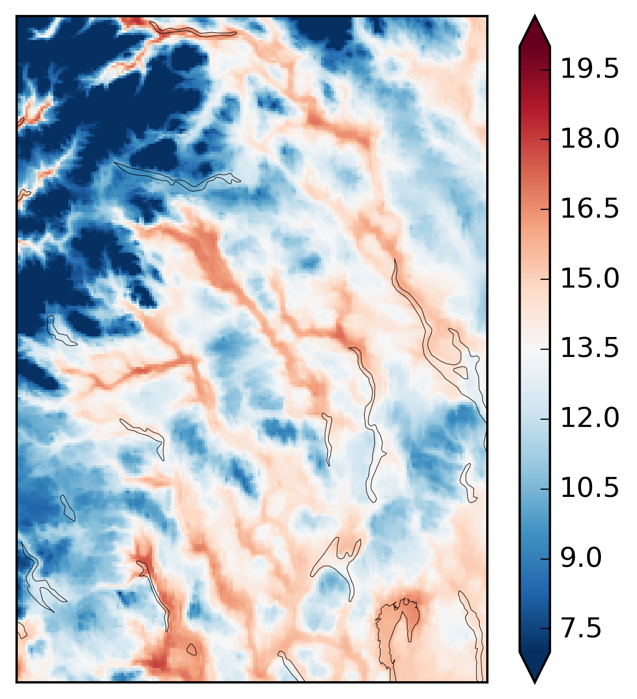
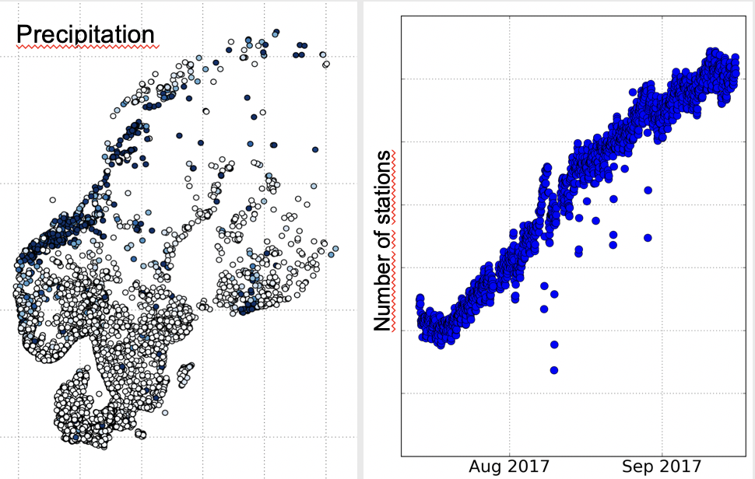
WP8 NetAtmo
(°C)
Temperature, pressure
Citizen observations network
Model
Model + Netatmo
Notes:
WP8

Slide 22
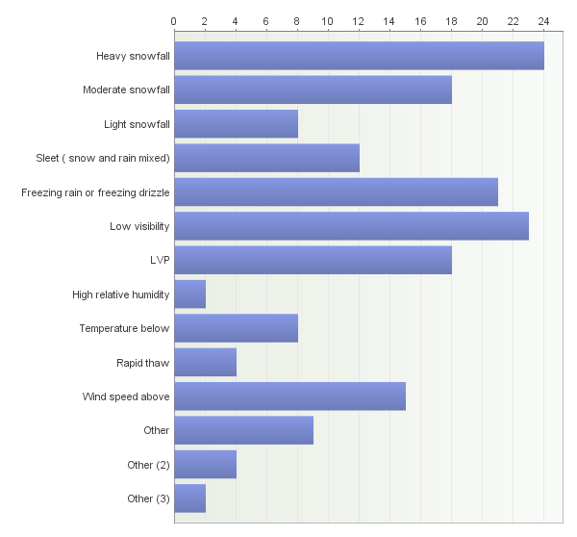
Airport users opinions– highest negative impact affecting on airport operations
Heavy snowfall
(low visibility)
Freezing rain and drizzle
Moderate snowfall
Wind speed above
Sleet
PNOWWA
PNOWWA
PNOWWA
PNOWWA
the type of winter weather affecting negatively to airport operation (PNOWWA survey)
Notes:
You can argue now with this? PNOWWA, Probabilistic Nowcasting of Winter Weather for Airports

Slide 23
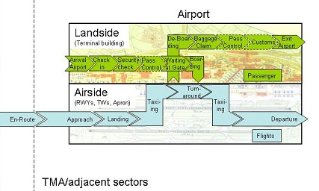
Winter Weather influencing to the Total Airport Management (TAM)
TAM
create an environment enabling airport partners to maintain a joint plan – the Airport Operations Plan
get full CDM (Collaborative Decision Making) benefits
  efficiency in airport
  enhanced use of airport resources
Extent time horizon from tactical to pre-tactical and strategic phases.
ROAD WEATHER -> Passengers, Buses, Taxis etc.
ROAD WEATHER -> Ground Handling, Ramp Agents
https://www.eurocontrol.int/eec/public/standard_page/EEC_News_2006_3_TAM.html
VISIBILITY -> Approach (and Tower)
RUNWAY STATE -> Runway Maintenance, Tower, Pilots
NEED OF DEICING? -> Airlines & De-icing agents and coordinators

Slide 24
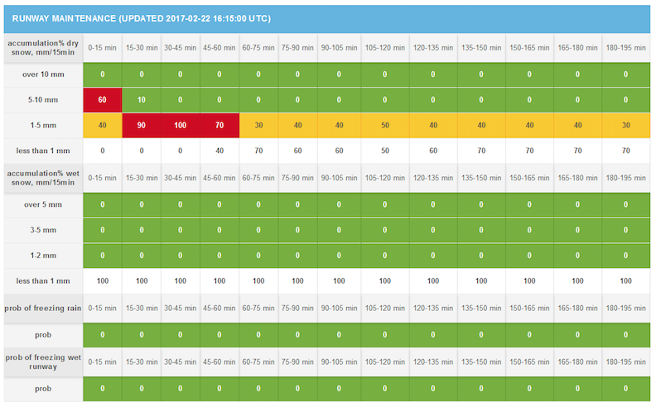
Runway maintenance demo
DRY SNOW
PROBABILITIES OF CLASSES (2017)EXCEEDANCE
PROBABILITIES (2018)
Wet
SNOW
FREEZING RAIN
FREEZING OF WET RUNWAYS
Notes:
Up to 3 hours. We aim at providing this information to longer time scales seamless way 6 hours to even couple of days (of course quality forecasts wil eventually decrease).

Slide 25
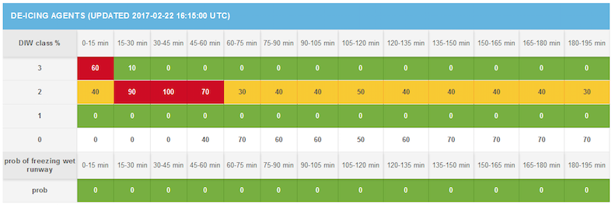
De-icing demo
De-icing time of individual airplane is directly dependent on the weather during stay of it on ground.
During weather conditions of high DIW de-icing time of aircraft is long.
DIW=3 -> ice or a lot of snow on the aircraft
DIW=2 -> some amount of snow on the aircraft
DIW=1 -> only frost on the aircraft
DIW=0 -> no de-icing need
Notes:
Up to 3 hours. We aim at providing this information to longer time scales seamless way 6 hours to even couple of days (of course quality forecasts wil eventually decrease).

Slide 26
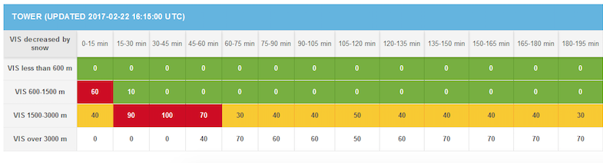
Tower demo
Notes:
Up to 3 hours. We aim at providing this information to longer time scales seamless way 6 hours to even couple of days (of course quality forecasts wil eventually decrease).
Only influence of snow precipitation is taken into account!
No fog, mist or drifting/blowing snow
Also to take into account fog, mist, drifting/blowing snow.

Slide 27
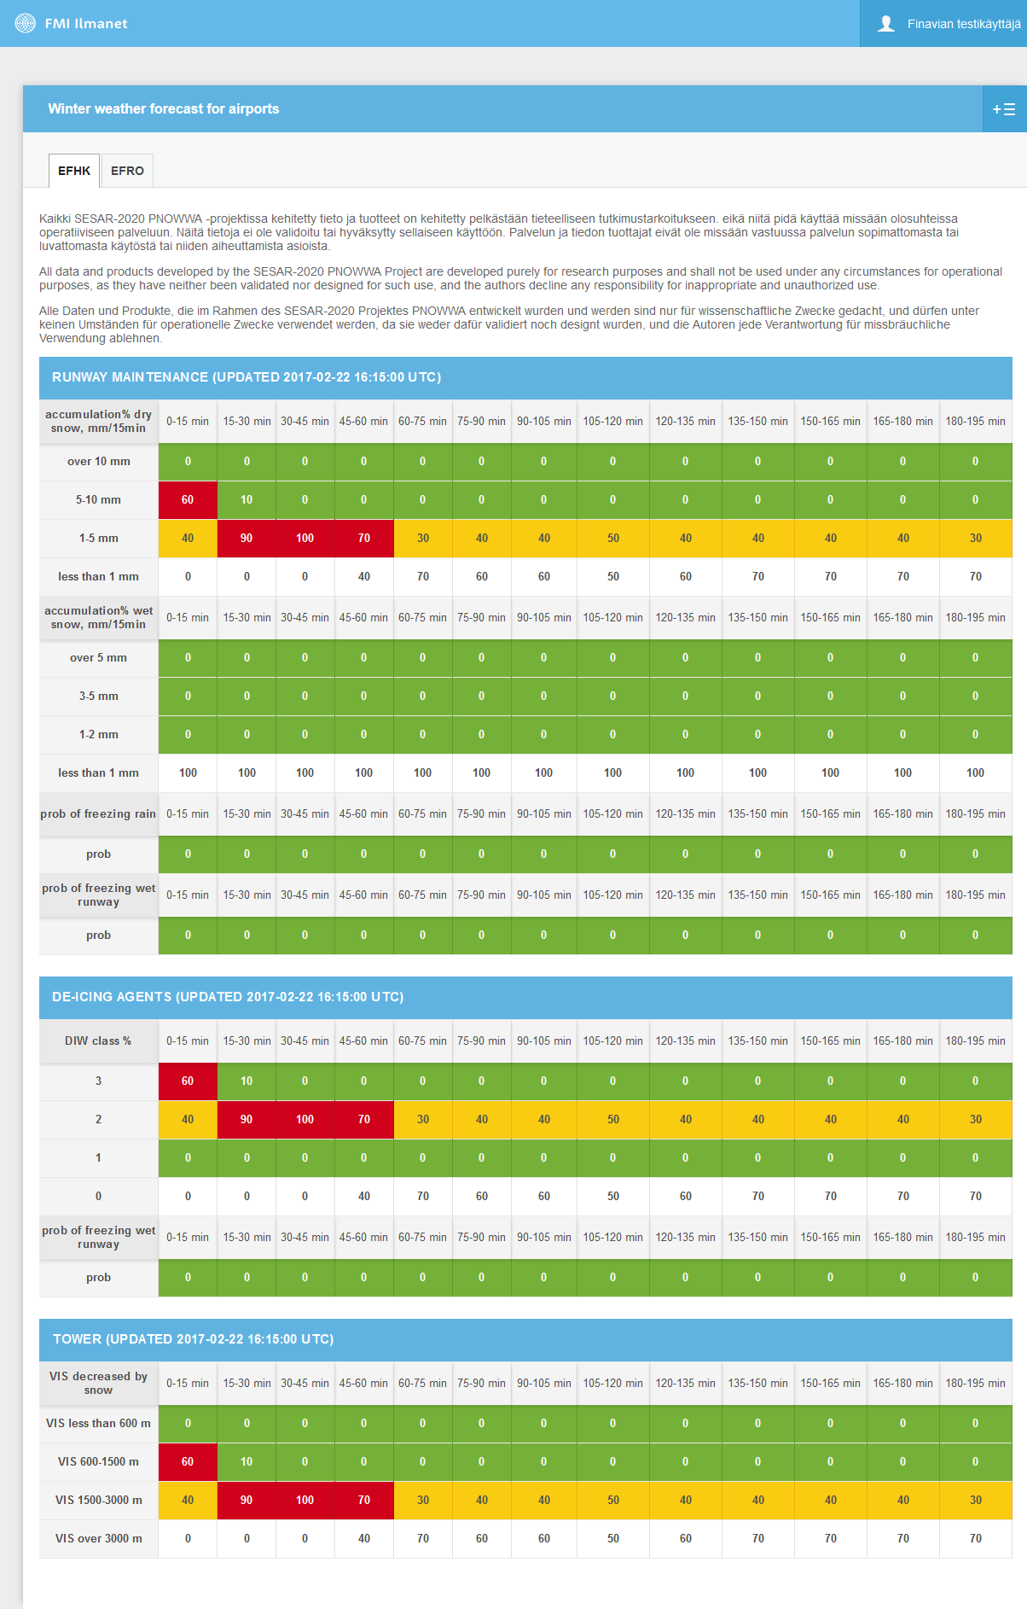
PNOWWA Scientific demo 2017
On line service with automatic update
Tailored products to:
  Runway maintenance
  De-icing agents
  Tower
Probabilities of the weather categories defined with users are used to individual users
Forecasted parameters:
  Accumulation of DRY snow
  Accumulation of WET snow
  Probability of freezing rain
  Probability of freezing of wet runways
  De-icing weather type (categories dependent on the time of individual plane de-icing duration
  Decrease of visibility CAUSED BY SNOW (fog or mist outscored)

Slide 28
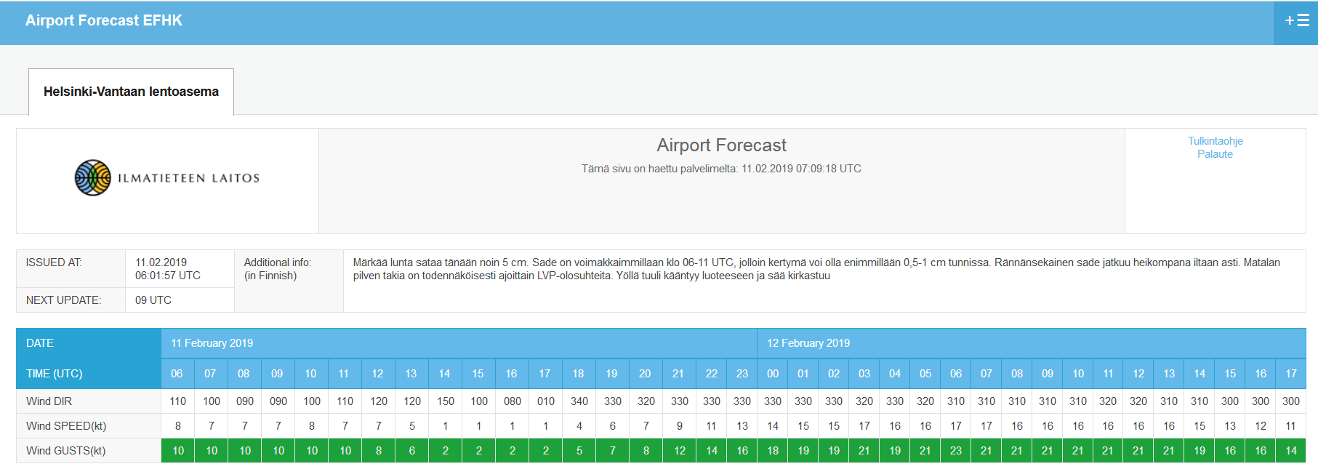
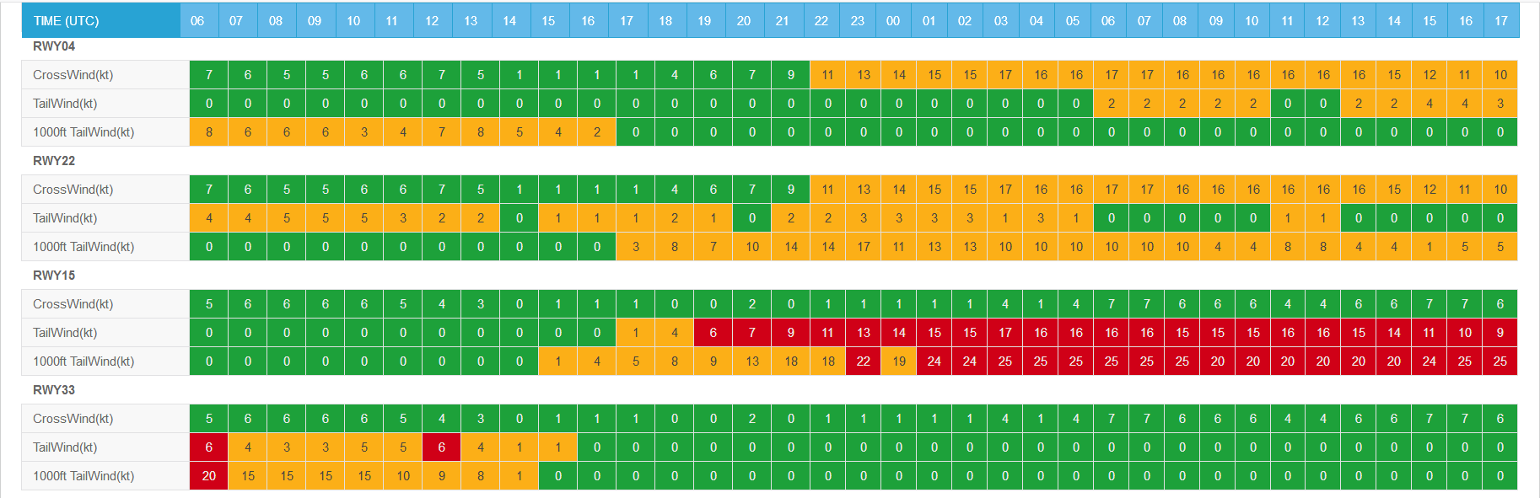
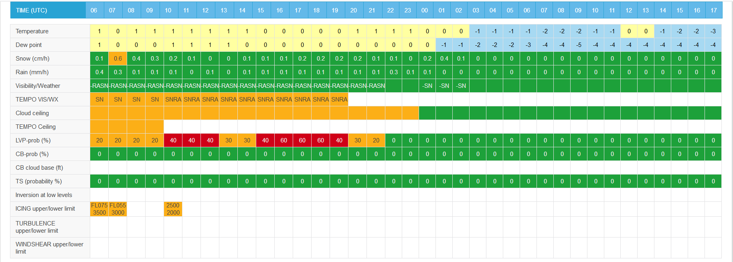
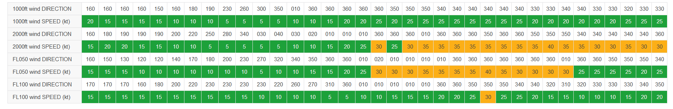
Airport Forecast
Notes:
Green weather has no impact, orange/yellow moderate impact, red high impact. Change during rush hour from green to red might mean increased workload for air traffic controller in duty.

Slide 29
5. Conclusions
FMI Nowcasting System (ULJAS) development well under way, but still early days to showcase impacts
  PNOWWA data will be included
  First real results by the end of 2019
Aims at providing all relevant meteorological variables and their probabilities
  Also winter precipitation with snow, wet snow, slush, freezing rain/drizzle will be included.
Output data will be but behind APIs
  Some of the data will be free to use
Workload: poor forecast?
Notes:
These should be changed. Only some FMI internal meaning. API application programming interfaces.
Strong mandate from FMI board of directors to implement nowcasting methods
Project requires resources from all corners of FMI and commitment from a large pool of experts

Slide 30
Thank you!
Jaakko.Nuottokari@fmi.fi
Head of Aviation and Defence
Finnish Meteorological Institute
Jarkko.Hirvonen@fmi.fi
Senior Meteorologist
Finnish Meteorological Institute

