Slide 1
Remote tower operations:
A professional staff organisation’s perspective
Eamonn Wylie – ATCO (UK)
On behalf of: Prospect ATCOs’ Branch (UK)
European Transport Workers’ Federation (ETF)
International Transport Workers’ Federation (ITF)
Workshop on DATS: Workload and safety assessment, Linköping University – Norrköping Campus, 11-12 Feb. 2019

Slide 2



Who are we?
Prospect ATCOs’ Branch
ETF
ITF

Slide 3
Remote towers – our position
Protect workers’ labour rights
Protect workers against any forced mobility issues
Maintain safety
In favour of technology assisting ATCOs
Licensing of remote tower ATCOs
More work to be done on sequential mode
Serious concerns for multiple mode

Slide 4
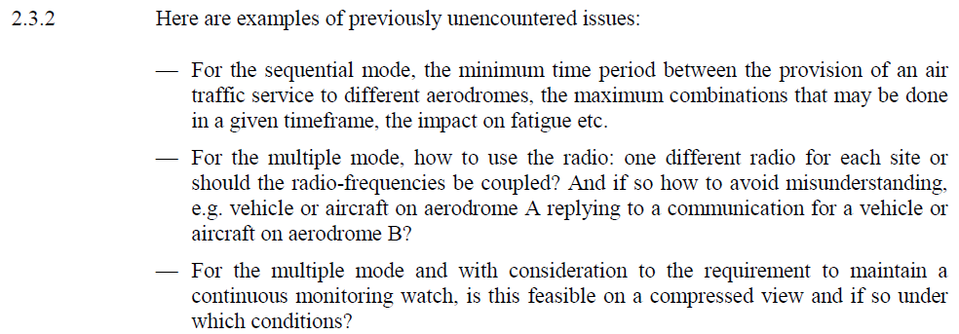
ITF submission to ICAO 13th ANC -
Some concerns with sequential/multiple mode
ITF submission to ICAO 13th ANC October 2019

Slide 5
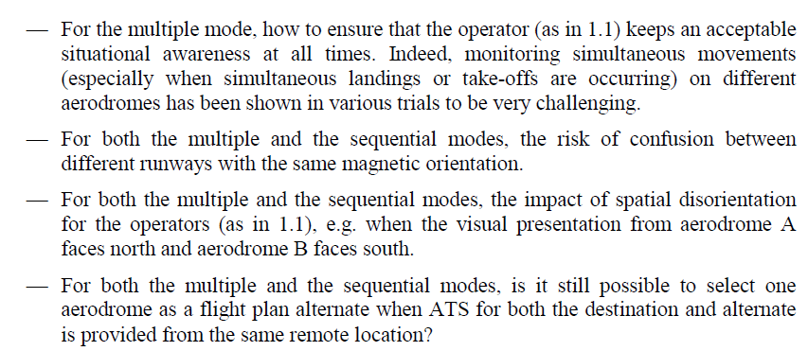
ITF submission to ICAO 13th ANC -
Some concerns with sequential/multiple mode
ITF submission to ICAO 13th ANC October 2019

Slide 6
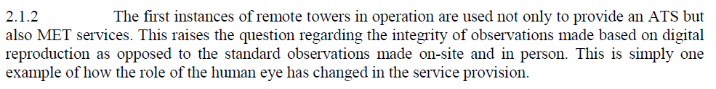
Weather impact on tower operation / for the delivery of ATS
Weather detection
Aerodrome lighting
LVPs
ITF submission to ICAO 13th ANC October 2019

Slide 7
ATCO workload evaluation
PSO engagement
Human factors
Multiple mode – are we looking at all the right things?

Slide 8
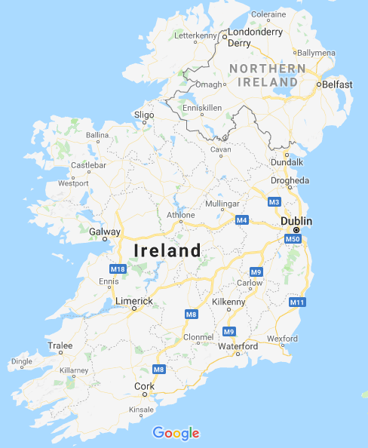

Slide 9
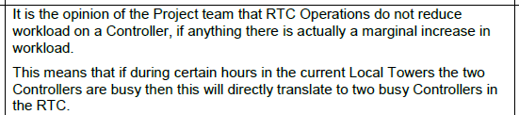
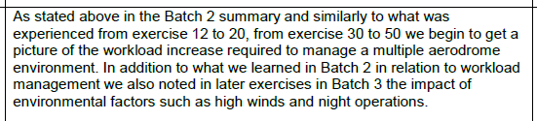
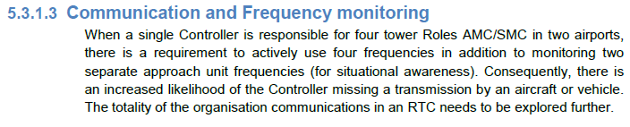
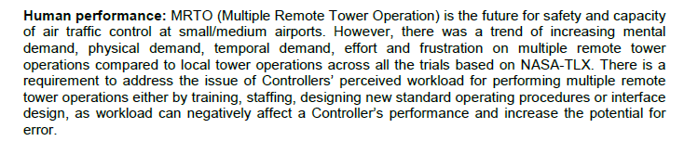

IAA trial – SESAR JU LSD 02.04

Slide 10
Safety assessment of digital ATS
PSO engagement & trust
Safety assessments – too limited?
IAA multiple mode trial – some examples

Slide 11
IAA trial – SESAR JU LSD 02.04
Limitations – timeframe

Slide 12
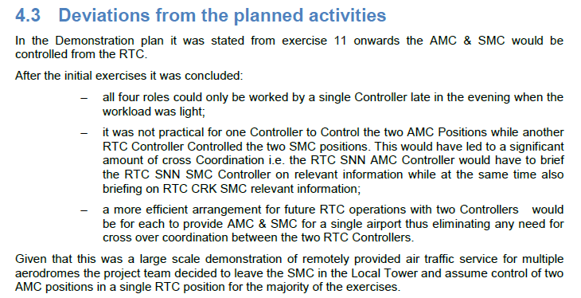
Limitations – scope (multiple mode)

Slide 13
Change management
PSO engagement
NPA 2017-21
UK CAP 1377 – ATM Automation: Guidance on human-technology integration

Slide 14
Digital tower services and challenges
Social impact
Community impact
Change to the service?
Cost analysis – who pays in the end?

Slide 15
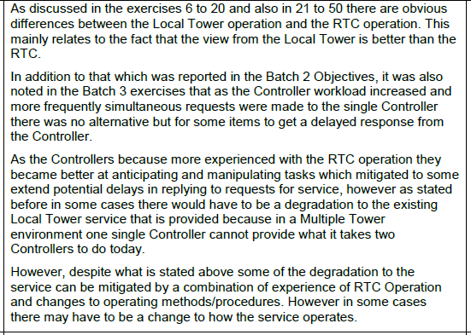
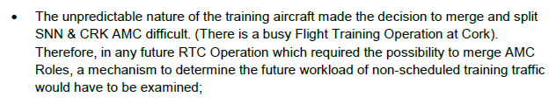
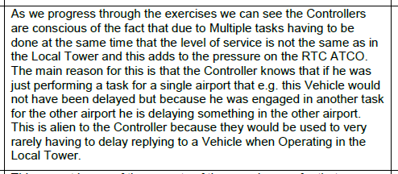
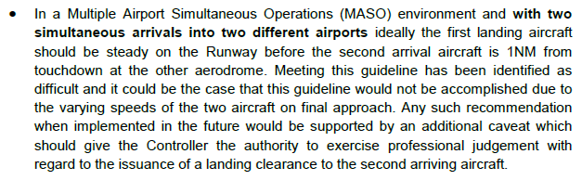
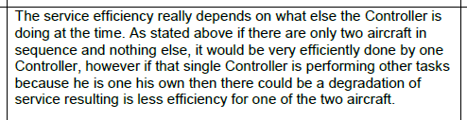
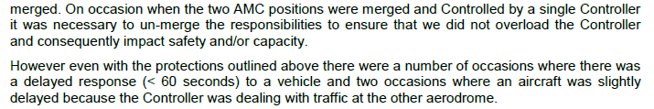
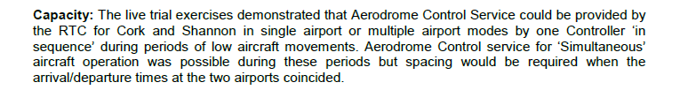
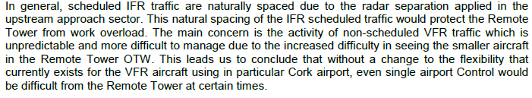
Change to the service?
IAA SESAR JU LSD 02.04:

Slide 16
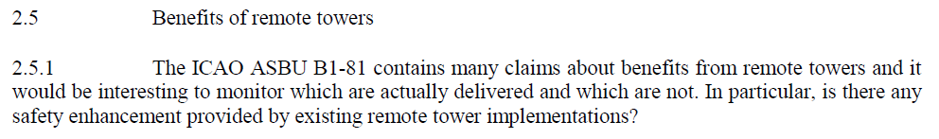
ITF submission to ICAO 13th ANC October 2019
Cost analysis – who pays in the end?

Slide 17
EASA NPA 2017-21
Is single mode there?
Will sequential and multiple mode get there?

Slide 18
Conclusion
Go slow & exercise caution
Trials and safety assessments must be thorough and engage with staff
Remember that ultra-safe ATM provision is not the result of an algorithm

Slide 19
Thank you
References:
www.atcos.co.uk www.etf-europe.org www.itfglobal.org
https://www.icao.int/Meetings/anconf13/Documents/WP/wp_214_en.pdf
eamonn.wylie@atcos.co.uk
Q&A?

