Slide 1


DATS Workshop on Digital Air Traffic Services: Workload and Safety Assessment
February 11-12th Feb 2021
Safety Assessment of Applying Digital Tower for Apron Control on International Airport
Wen-Chin Li BSc PhD FCIEHF C.ErgHF
Safety and Accident Investigation Centre, Cranfield University, U.K.
Notes:
Good afternoon, lady and gentlemen. I am Wen-Chin Li from Cranfield University, United Kingdom.
Today I would like to present the influence of flight deck interface design on pilots’ situation awareness and perceived workload

Slide 2


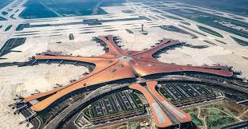
Overview
Background of Project
Why Applies Digital Tower for Apron Control?
Safety Assessment on Digital Tower Operations
Findings and Discussions
Experience Shared
Q & A
Notes:
This is the overview of my presentation

Slide 3

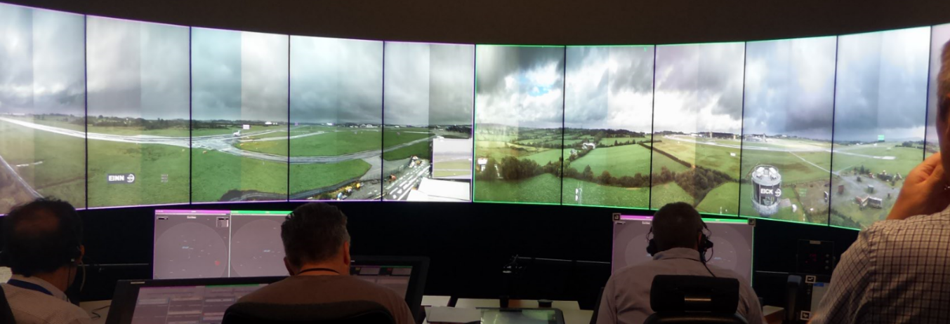
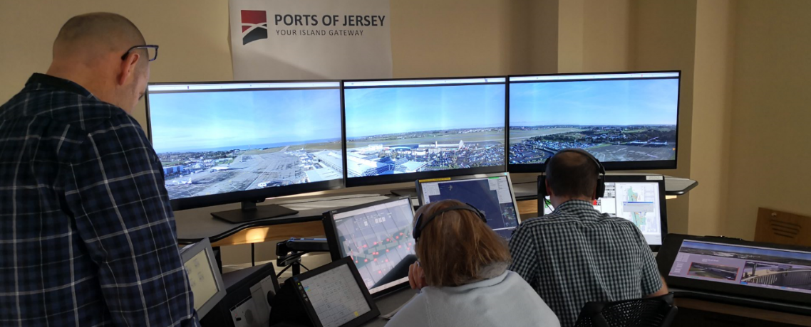

SESAR ATM Operational Step Timeline

Slide 4
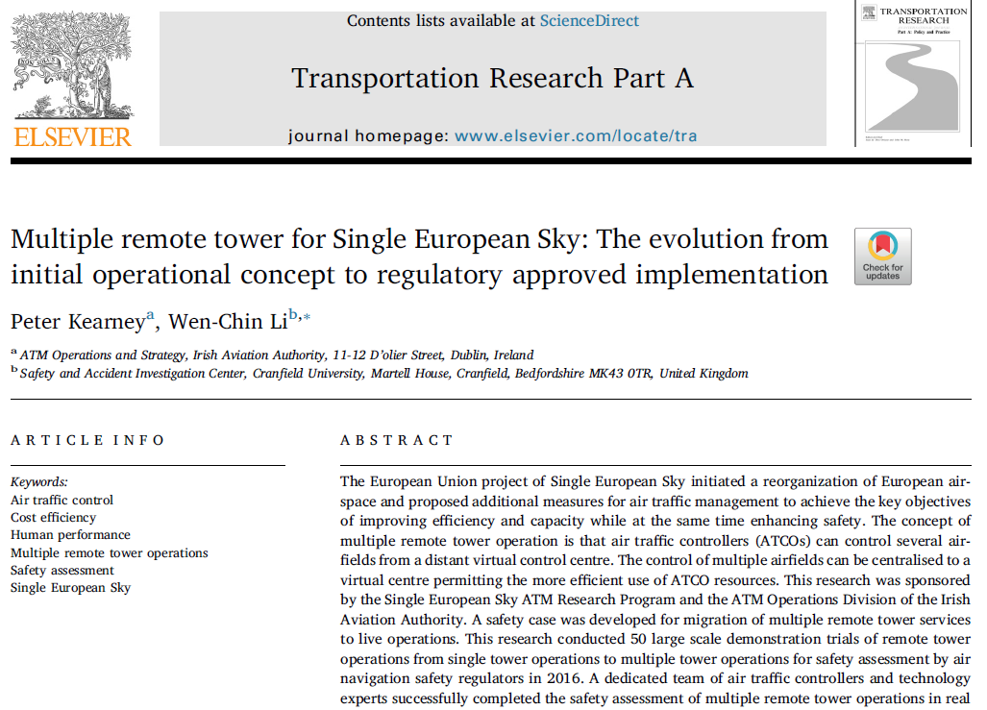

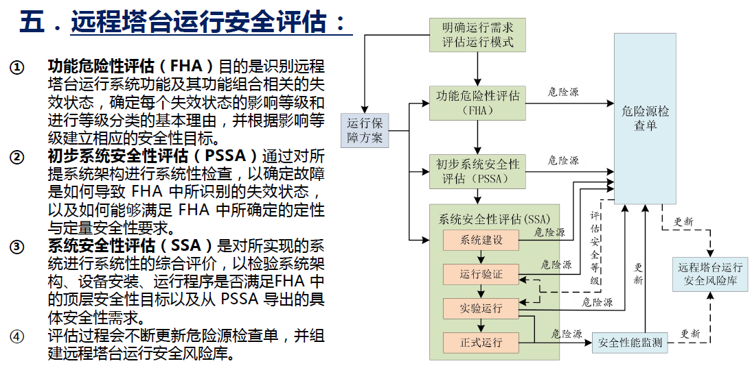
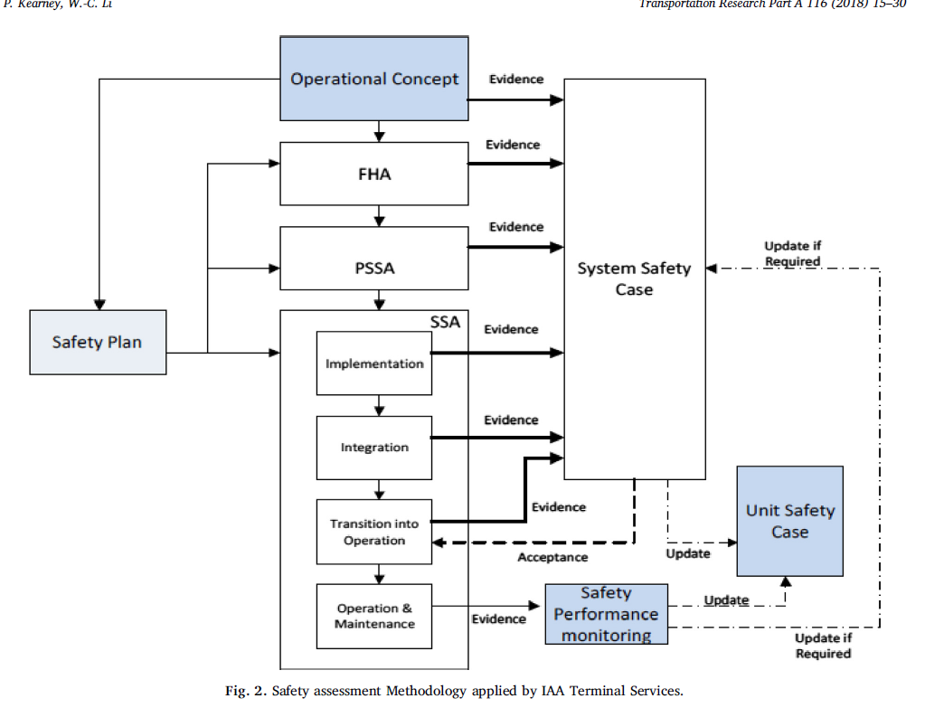

Slide 5

Why Applies Digital Tower for Apron Control?
Is it suitable to apply digital tower for apron control on international airport?
What are the processes of training and certification for apron controllers?
How to conduct safety assessment on digital tower for apron control?
How to oversee the safety of operations and human performance?

Slide 6

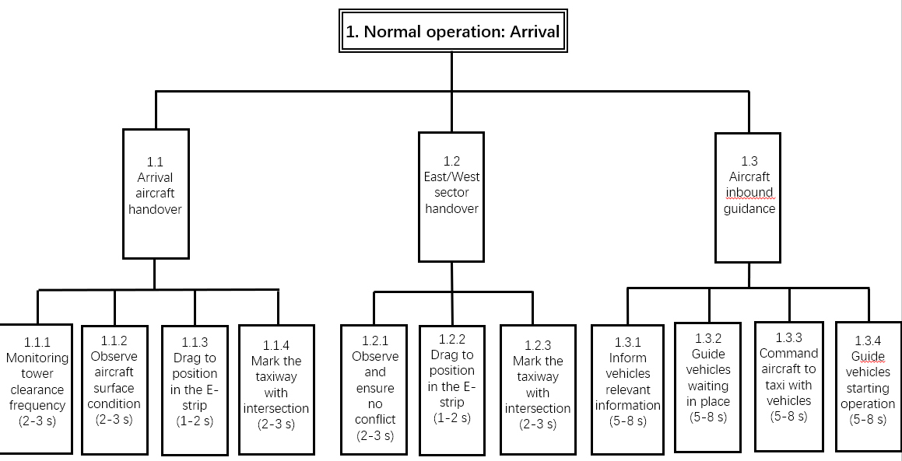
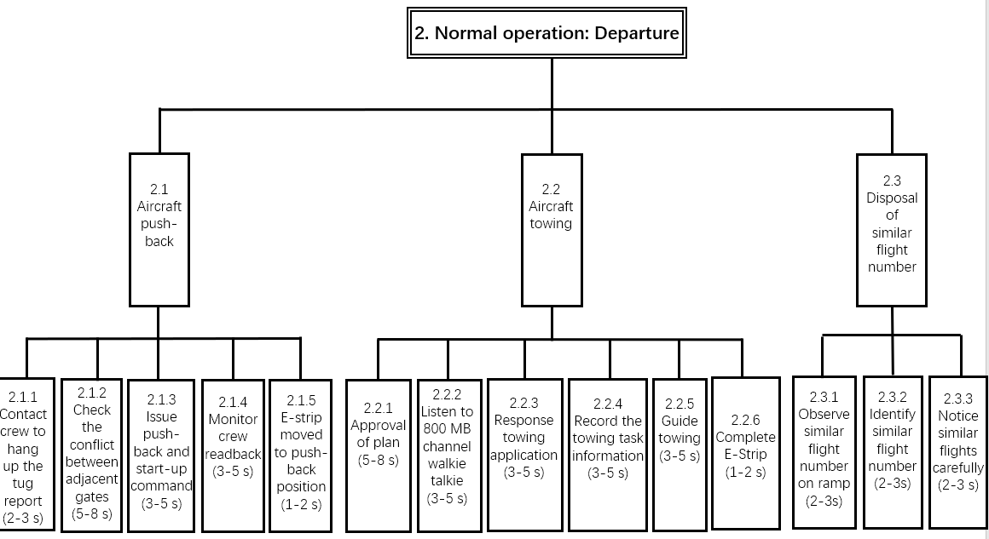
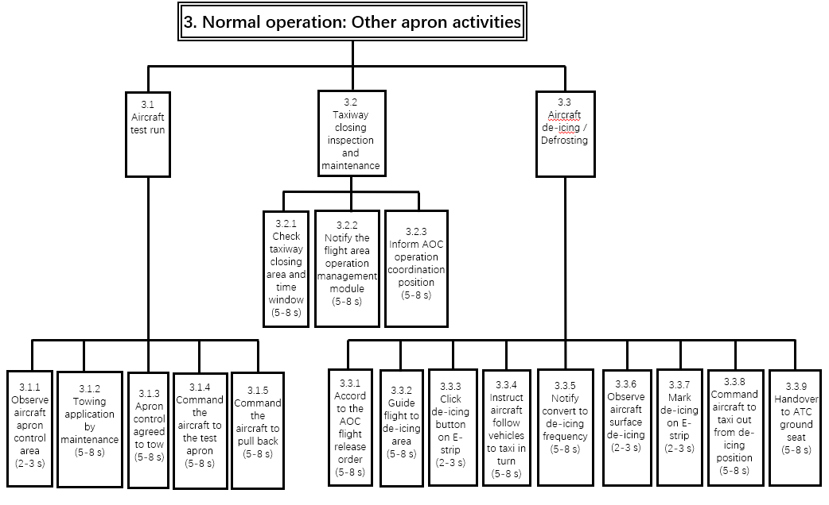
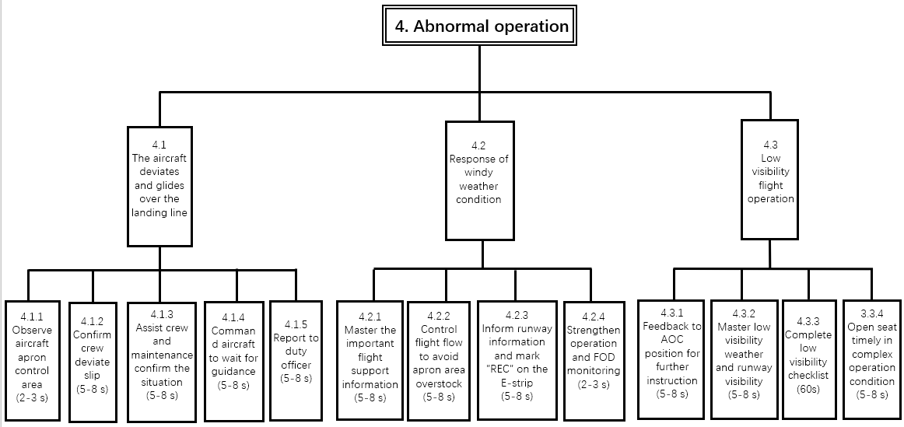
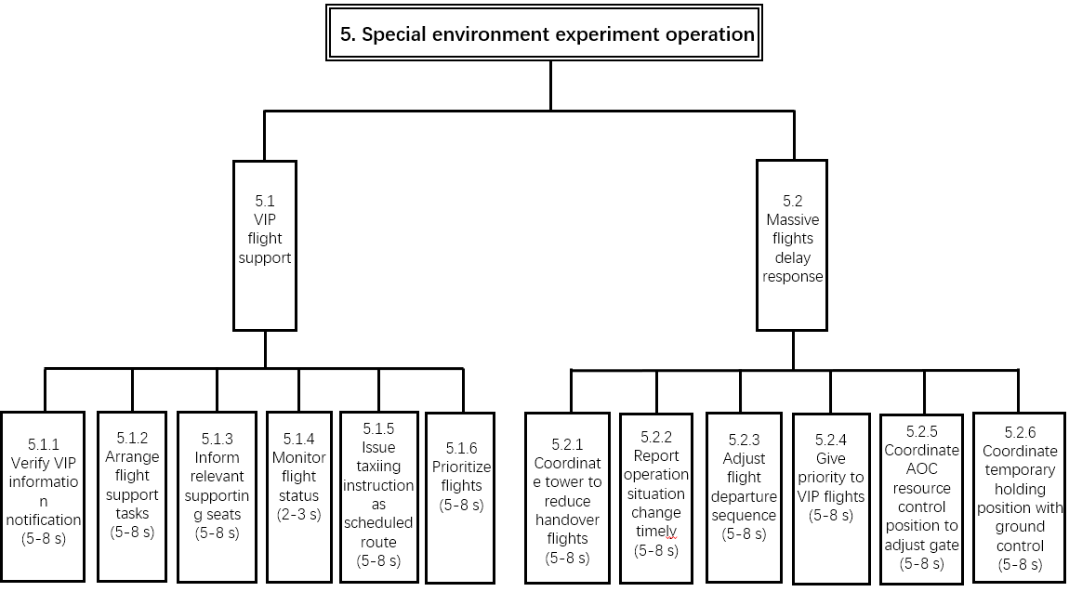
HTA of Apron Control using Digital Tower

Slide 7
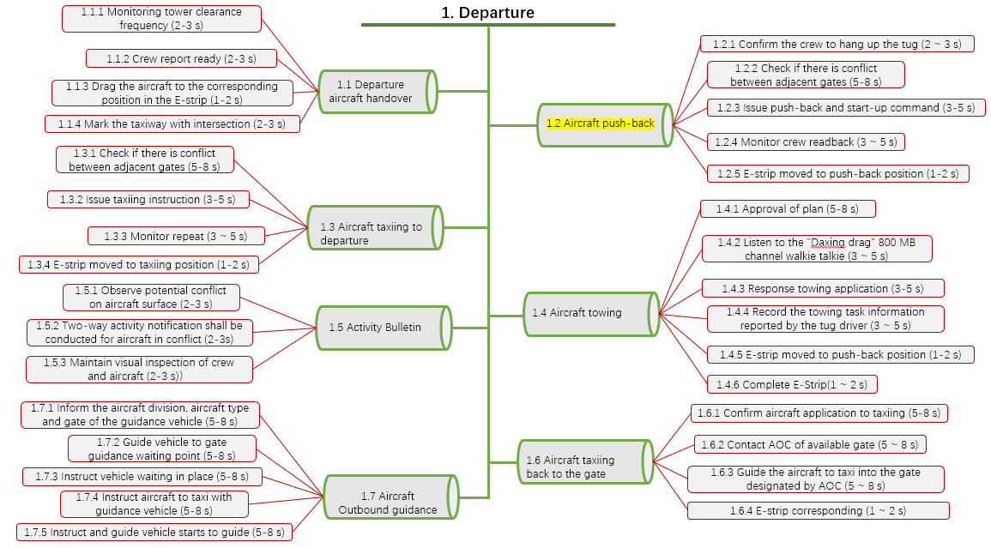
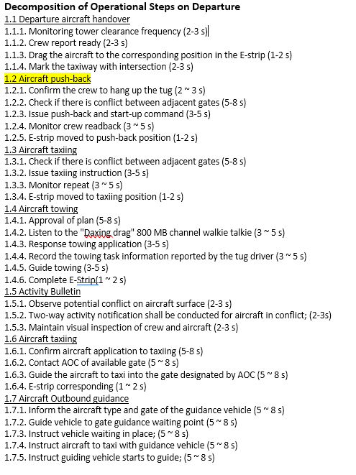
Overall Goal of Task: Departure
The tasks consist with 7 sub-goals and 31 operational steps to complete the overall task of departure

Slide 8
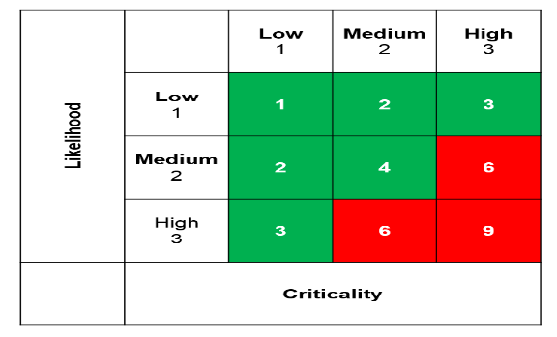

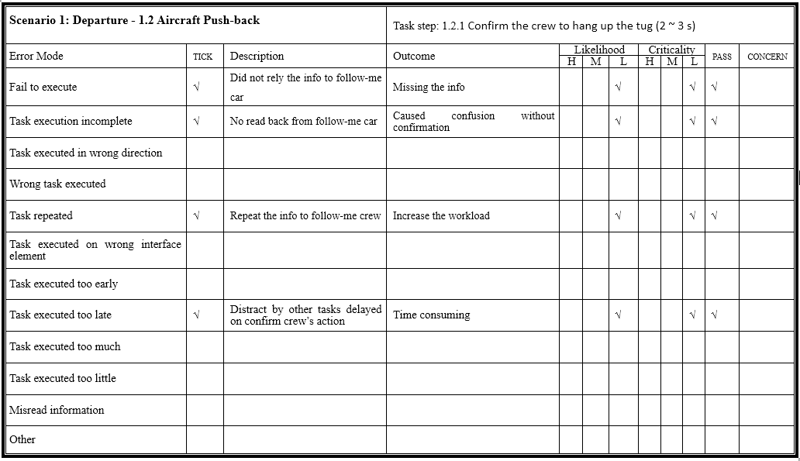
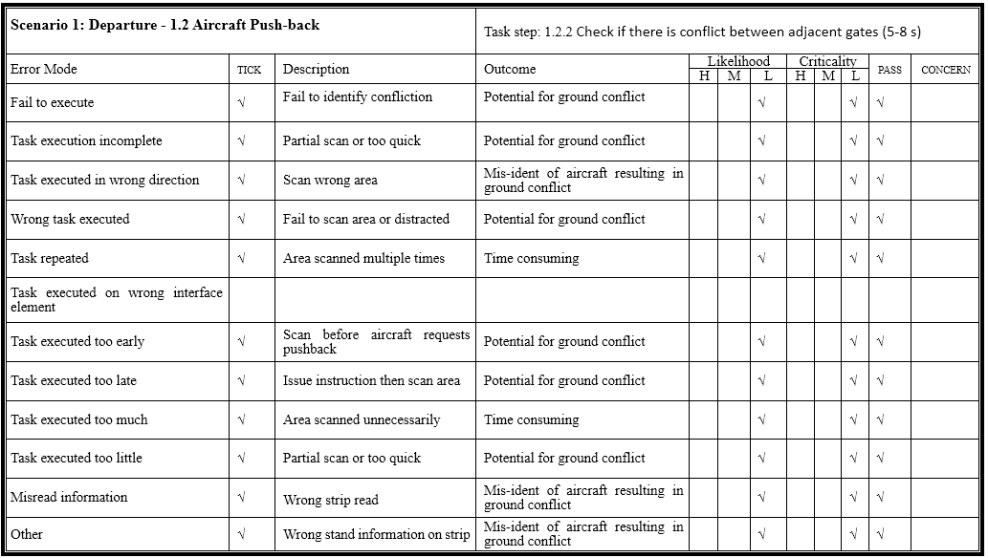
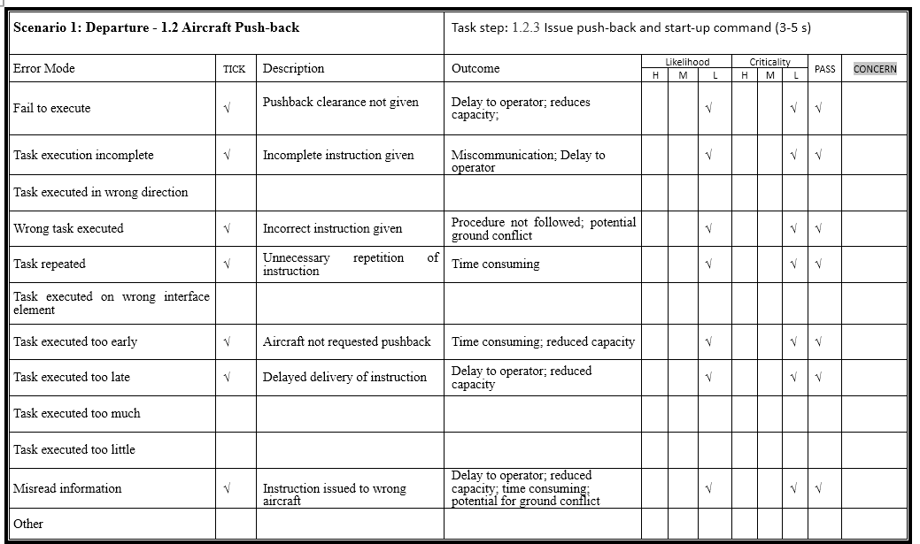
Likelihood and criticality matrix with the Pass and Caution on the HET

Slide 9
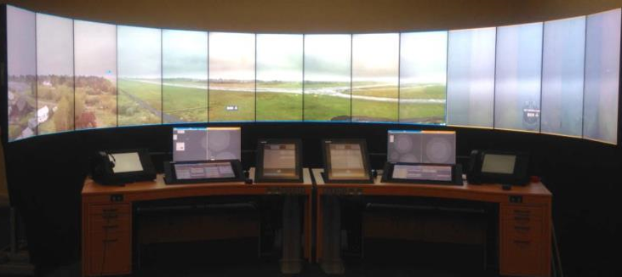
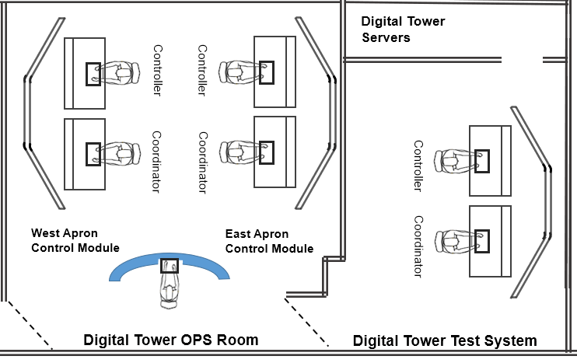
The Design of Workplace for Apron Controllers
Target Identifications between 55 inches and 43 inches of Screens

Slide 10
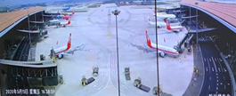
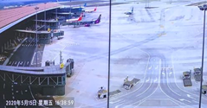
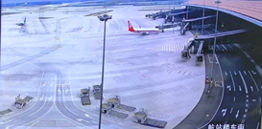
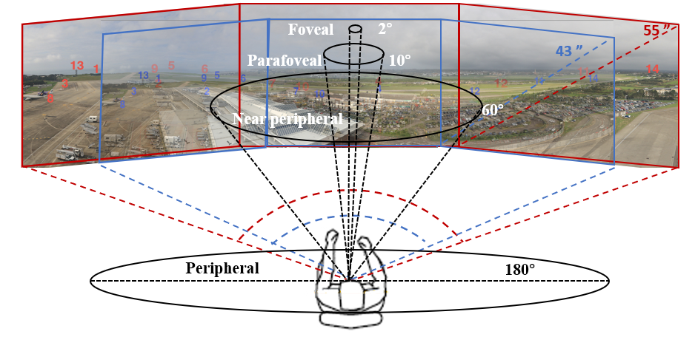
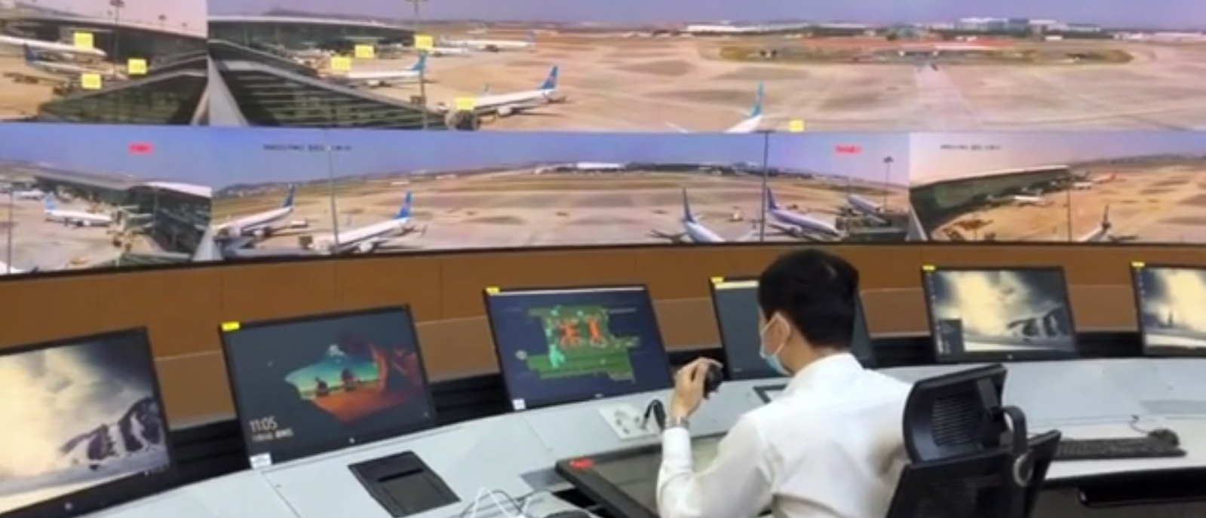

OTW and PTZ on Digital Tower for Apron Control
Are bigger OTW better for target identification on digital tower?
文本
5°~10°
图形
5°~30°
颜色
30°~60°
动作
-94°~62°

Slide 11
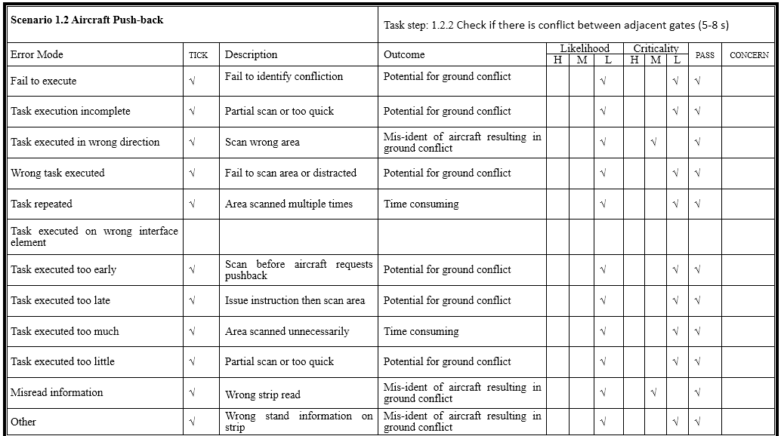
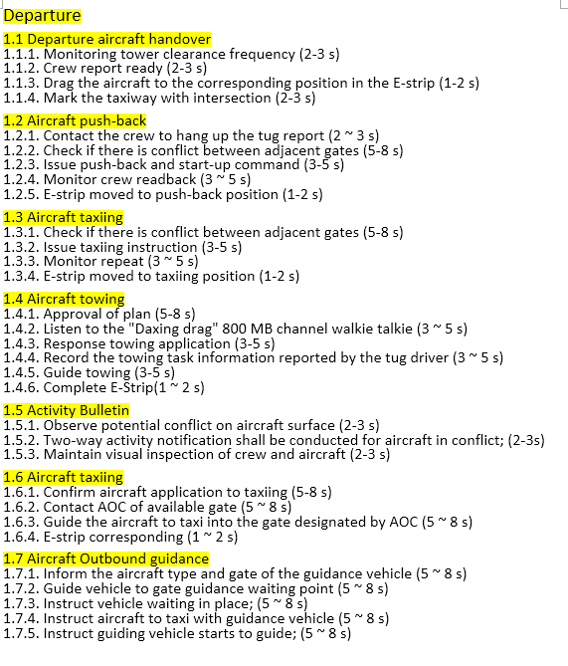
Findings of Applied HTA and HET for Apron Control
The majority of participants agreed that HTA and HET are suitable approach to investigate digital tower for apron control
The results demonstrated that there is no safety concern on operational steps related to apron control using digital tower
There are different opinions between senior and junior controllers on digital tower for apron control (usability, system safety, perceived workload…)
The HTA and HET methods can be applied to develop SOPs to deal with emergent situations and provided documentations for certification
Change Management was identified as critical to successful implementation of digital tower for apron control

Slide 12



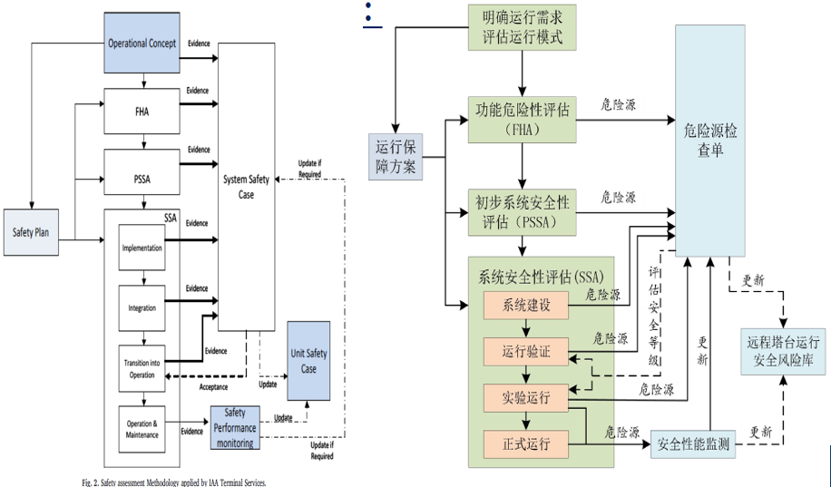
Experience Shared:
Ripple in a pond
Resistance to Change…
Ripple in a Pond: Regulators, Operators, Consultancy, Controllers...
Gaps between Different Professional Groups…
Cultural Differences on expectation and interpretation (translation)
New Pattern of Work after Pandemic

Slide 13
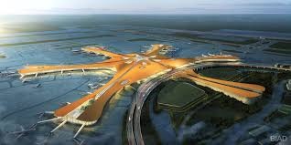
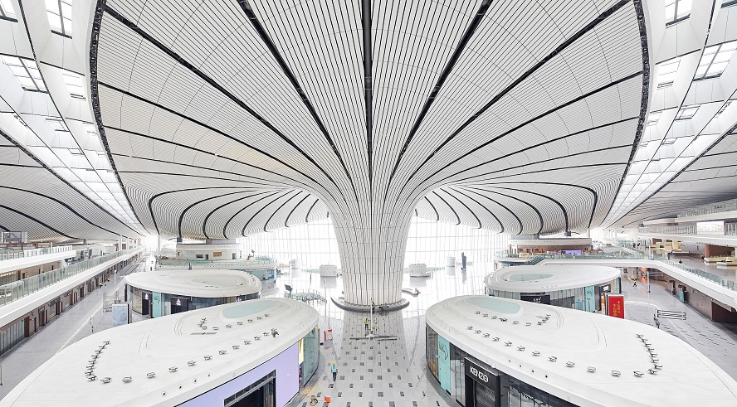
Thanks
Q & A
Wen-Chin Li PhD. FCIEHF C.ErgHF.
Senior Lecturer
Safety and Accident Investigation Centre,
Cranfield University, U.K.
E-mail: wenchin.li@cranfield.ac.uk

