Slide 1
Data Transmission and Base-Station Placement for Optimizing Network Lifetime Esther M. Arkin and Joseph S. B. Mitchell Stony Brook University Swaminathan Sankararaman, Javad Taheri Alon Efrat, Srinivasan Ramasubramanian U of Arizona Valentin Polishchuk U of Helsinki

Slide 2
Problem Formalization (1)
Given: a set of sensors S={s₁…s_{n}}, and a basestation BS. Need to find a topology – a forwarding scheme (who sends data to whom) to prolong the time the first sensor die.
Assumptions:
Each sensor generates F bits/second, all have to reach the basestation (no bit is left behind).
All sensors have identical batteries.
Rayleigh fading model - energy needed for sending a bit x➔y increases as distance squared.
BS
s₁₄
s₁
s₁₃
s₃₄

Slide 3
More Interesting Problem
Where should we place the Basestation to maximize system’s lifetime ?
BS
s₁₄
s₁
s₁₃
s₃₄

Slide 4
Topologies – what is this obsession about trees.
(and what about interference ?)
Answer: We assume that sensors are deactivated for long periods (sleeping). In a tree topology, clock synchronization is relatively easy, comparing to arbitrary DAGs.

Slide 5
And what’s the deal with 2-trees ?
We would consider only topologies which are trees where each sensor is of distance ≤ 2 from the basestation.
Delay time is limited
Simplicity of protocol
3-trees (or more) are NP-Hard (in this paper)
Polynomiallity.
Side comment – if any DAG solution is acceptable then a simple LP solution finds optimum forwarding scheme for the fixed BS problem (in ideal conditions)
For the dual problem where the BS location need to be found, a (1-ε) approximation algorithm exits [Efrat, Har-Peled, Mitchell 05]

Slide 6
Fixed BS - the decision problem
Given a time duration τ either find a forwarding scheme that enables the system to survive this duration, or determine that no such topology exist.
Algorithm –
compute d* - the crucial radius – for which a sensor within this distance could transmit all its data directly to the basestation (no relaying is needed) for time τ. Observe that d* is universal to all sensors.
Find the set of cluster-heads – sensors within distance d* from BS. The other sensors are leaves.
BS
d*
Next need to find an assignment specifying which leaf to connect to which ClusterHead

Slide 7
Computing the assignment
A ClusterHead s_{i} can transmit all its own data for time duration τ
In addition, possibly it could relay other sensors’ data – depending on its distance d(s_{i} , BS).
Let c_{i} denote the number of other sensors s_{i} can relay.
The assignment problem: Need to connect each leaf s_{j} to a ClusterHead s_{i} such that
d(s_{i} , s_{j} ) ≤ d*
The number of sensors relayed by s_{i}
cannot exceed c_{i}
BS
d*
s_{i}
Smells somehow like bipartite matching
s_{j}

Slide 8
Computing the assignment-cont
Connect each leaf s_{i} to a ClusterHead s_{i} such that
d(s_{i} , s_{j} ) ≤d*
The number of sensors connected to s_{i} ≤ c_{i}
Def:
This assignment is perfect if all leaves are connected.
ClusterHead s_{i} is saturated if it is assigned to c_{i} leaves.
E the set of all edges between pairs (leaf, CH) whose distance is ≤ d*.
Warmup Lemma: Assume M is an assignment at which leaf s_{j} is not assigned to a CH. Then if a perfect assignment exists then there is an augmenting (alternating) path π
starting at s_{j}
ending at non-saturated ClusterHead s_{i}
alternating between edges of E which participates (resp. does not participate) in the assignment.
1
1
s_{i}
s_{j}
1
BS
Proof – immediate from flow algorithms

Slide 9
Computing the assignment
To obtain efficient algorithm, we need to recycle some ancient results:
Given a set of unit disks S={D₁, ..D_{n}} in the plane, we have a data structure that supports
- Finding a disk of S containing a query point q
- Deleting this disk
Each in O(log n) time. [Efrat, Katz, Itai 95]
Applications: Assume that
the centers of the disks are
the ClusterHeads,
the radius of the disks is d*
q is actually a leaf s_{j}
Then by repeating these operations we can find all Clusterheads which are neighbors of s_{j}.
q
Actually, we can grow a BFS trees of alternating paths, rooted at s_{j} in O(n log n) time.

Slide 10
Computing the assignment
By expanding Dinic’ matching algorithm, we can actually find the assignment in O(n^{3/2} log n)
If an edge is deleted/inserted, or if c_{i} is incremented/decremented, we can update the assignment in O( n log n) per event
Next lets find optimum location of the basestation

Slide 11
Orbits around s_{i} for a fixed duration τ
s_{i} can transmit its data to any point in this disk for duration τ
s_{i}
s_{i} can transmit all its data, and data received from 2 other sensors
s_{i} can transmit all its data, and data relayed from 1 another sensor

Slide 12
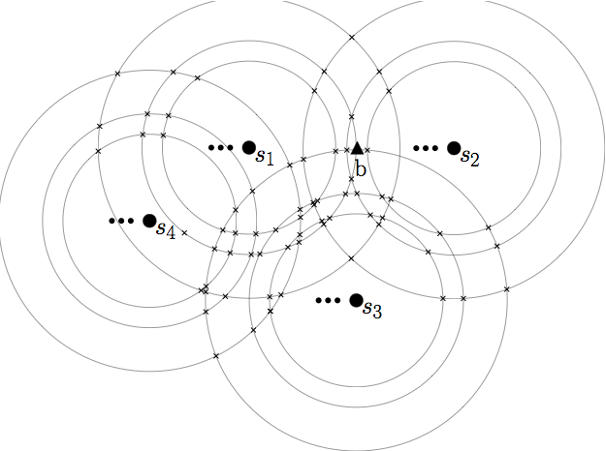
Finding opt location of a basestaion – fixed duration
For each sensor compute its orbits.
We compute the assignment at each vertex of this arrangement (using previous algorithm)
O(n log n) per vertex,
or O(n⁵ log n) altogether

Slide 13
Finding optimum duration
Use parametric search of Megiddo + improvements by Cole
Use AKS sorting networks to sort the vertices between disks. This is the generic algorithm generating critical durations τ
Use previous algorithm as an oracle to determine if τ is too small/large

Slide 14
Finding 3-Level Trees is NP-Hard
Hard even in the case of finite data transmission (no issue of maximizing lifetime).
Maximum distance to which sensor can transmit data of x sensors:
d_{x} = x^{−(1/ α)} , for some 2 ≤ α ≤ 4
Decision Problem:
Given a set of sensors S and a location of the base-station BS, does there exist a transmission protocol (with arbitrarily many levels) enabling all sensors to transmit their data to BS.
Reduction from 3-PARTITION Problem:
Given a set of integers a₁, . . . ,a_{3n}, where each a_{i} is between B/2 and B/4 for B = Σ a_{i}/n = O(1), decide if it is possible to split them into n groups of 3 so that the sum of the integers in every group is the same.

Slide 15
Construction
For an instance of 3-PARTITION, place 3 types of sensors:
n clusterheads (c) at distance d_{B+1} to the left of BS
3n elements (i) on semicircle of radius d_{B/2} around c away from BS (close to the horizontal line)
a_{i}−1 atoms (s_{i}) at distance d₁ on ray from c through i where
B/4 ≤ a_{i} ≤ B/2
Solution for Decision Problem (if there exists a tree)
↕
Solution for 3-PARTITION (partition element sensors into groups of 3 transmitting to same clusterhead)

Slide 16
Proof
Idea: elements i grouped according to solution of 3-PARTITION
Forward: 3-PARTITION implies 3-Level Tree
Elements in each group transmit to one clusterhead
Backward: 3-Level tree implies 3-PARTITION
Atoms must transmit to elements
Elements cannot transmit directly to BS, since
d_{B+1} + d_{B/2} > d_{B/4},
Hence, elements must transmit to c
Elements must be split evenly among clusterheads, since no clusterhead can transmit more than B+1 sensors

